Slide 1
SQL & QUERY OPTIMIZATION

Slide 2
SQL Standards - Data types - Database Objects- DDL-DML-DCL-TCL-Embedded SQL-Static Vs Dynamic SQL - QUERY OPTIMIZATION: Query Processing and Optimization - Heuristics and Cost Estimates in Query Optimization.

Slide 3
SQL Standards
What is SQL?
SQL stands for Structured Query Language
SQL lets you access and manipulate databases
SQL is an ANSI (American National Standards Institute) standard

Slide 4
SQL STANDARDS(CONTD..)
What Can SQL do?
SQL can execute queries against a database
SQL can retrieve data from a database
SQL can insert records in a database
SQL can update records in a database
SQL can delete records from a database
SQL can create new databases
SQL can create new tables in a database
SQL can create stored procedures in a database
SQL can create views in a database
SQL can set permissions on tables, procedures, and views

Slide 5
TYPES OF SQL COMMANDS
These functions include building database objects, manipulating objects, populating database tables with data, updating existing data in tables, deleting data, performing database queries, controlling database access, and overall database administration.
The main categories are
DDL (Data Definition Language)
DML (Data Manipulation Language)
DQL (Data Query Language)
DCL (Data Control Language)
Data administration commands
Transactional control commands

Slide 6
TYPES OF SQL COMMANDS(CONTD..)
DDL (Data Definition Language)[Defining Database Structures]
Data Definition Language, DDL , is the part of SQL that allows a database user to create and restructure database objects, such as the creation or the deletion of a table.
Some of the most fundamental DDL commands include the following:
CREATE TABLE
ALTER TABLE
DROP TABLE
CREATE INDEX
ALTER INDEX
DROP INDEX
CREATE VIEW
DROP VIEW

Slide 7
TYPES OF SQL COMMANDS(CONTD..)
Data Manipulation Language(DML)[Manipulating Data]
Data Manipulation Language, DML , is the part of SQL used to manipulate data within objects of a relational database.
There are three basic DML commands:
INSERT
UPDATE
DELETE
Data Query Language (DQL)
Though comprised of only one command, Data Query Language (DQL) is the most concentrated focus of SQL for modern relational database users. The base command is as follows:
SELECT
This command, accompanied by many options and clauses, is used to compose queries against a relational database.

Slide 8
TYPES OF SQL COMMANDS(CONTD..)
Data Control Language(DCL)
Data control commands in SQL allow you to control access to data within the database. These DCL commands are normally used to create objects related to user access and also control the distribution of privileges among users. Some data control commands are as follows:
ALTER PASSWORD
GRANT
REVOKE
CREATE SYNONYM

Slide 9
TYPES OF SQL COMMANDS(CONTD..)
Transactional Control Commands
In addition to the previously introduced categories of commands, there are commands that allow the user to manage database transactions.
COMMIT Saves database transactions
ROLLBACK Undoes database transactions
SAVEPOINT Creates points within groups of transactions in which to ROLLBACK
SET TRANSACTION Places a name on a transaction

Slide 10
SQL OPERATORS
An operator is a reserved word or a character used primarily in an SQL statement's WHERE clause to perform operation(s), such as comparisons and arithmetic operations.
These Operators are used to specify conditions in an SQL statement and to serve as conjunctions for multiple conditions in a statement.
Arithmetic operators
Comparison operators
Logical operators
Operators used to negate conditions

Slide 11
SQL Arithmetic Operators
Assume 'variable a' holds 10 and 'variable b' holds 20, then −
Operator | Description | Example
+ Addition | Adds values on either side of the operator. | a + b will give 30
- Subtraction | Subtracts right hand operand from left hand operand. | a - b will give -10
* Multiplication | Multiplies values on either side of the operator. | a * b will give 200
/ Division | Divides left hand operand by right hand operand. | b / a will give 2
% Modulus | Divides left hand operand by right hand operand and returns remainder. | b % a will give 0

Slide 12
SQL Comparison Operators
Assume 'variable a' holds 10 and 'variable b' holds 20, then −
Operator | Description | Example
= | Checks if the values of two operands are equal or not, if yes then condition becomes true. | a=b is not true.
!= | Checks if the values of two operands are equal or not, if values are not equal then condition becomes true. | a!=b is true.
<> | Checks if the values of two operands are equal or not, if values are not equal then condition becomes true. | a<>b is true.
> | Checks if the value of left operand is greater than the value of right operand, if yes then condition becomes true. | a>b is not true.
< | Checks if the value of left operand is less than the value of right operand, if yes then condition becomes true. | a<b is true.
>= | Checks if the value of left operand is greater than or equal to the value of right operand, if yes then condition becomes true. | a>=b is not true.
<= | Checks if the value of left operand is less than or equal to the value of right operand, if yes then condition becomes true. | a<=b is true.
!< | Checks if the value of left operand is not less than the value of right operand, if yes then condition becomes true. | a!<b is false.
!> | Checks if the value of left operand is not greater than the value of right operand, if yes then condition becomes true. | a!>b is true.

Slide 13
SQL Logical Operators
Here is a list of all the logical operators available in SQL.
Sr.No. | Operator & Description
1 | ALL The ALL operator is used to compare a value to all values in another value set.
2 | AND The AND operator allows the existence of multiple conditions in an SQL statement's WHERE clause.
3 | ANY The ANY operator is used to compare a value to any applicable value in the list as per the condition.
4 | BETWEEN The BETWEEN operator is used to search for values that are within a set of values, given the minimum value and the maximum value.
5 | EXISTS The EXISTS operator is used to search for the presence of a row in a specified table that meets a certain criterion.
6 | IN The IN operator is used to compare a value to a list of literal values that have been specified.

Slide 14
SQL Logical Operators
7 | LIKE The LIKE operator is used to compare a value to similar values using wildcard operators.
8 | NOT The NOT operator reverses the meaning of the logical operator with which it is used. Eg: NOT EXISTS, NOT BETWEEN, NOT IN, etc. This is a negate operator.
9 | OR The OR operator is used to combine multiple conditions in an SQL statement's WHERE clause.
10 | IS NULL The NULL operator is used to compare a value with a NULL value.
11 | UNIQUE The UNIQUE operator searches every row of a specified table for uniqueness no duplicates

Slide 15
SQL OPERATORS
Set Operators:
OPERATOR | DEFINITION
UNION | Returns all distinct rows from both queries
INTERSECT | Returns common rows selected by both queries
MINUS | Return all distinct rows that are in the first query , but not in second one

Slide 16
DATA TYPE
Data type | Description
CHARACTER(n) | Character string. Fixed-length n
VARCHAR(n) or CHARACTER VARYING(n) | Character string. Variable length. Maximum length n
VARBINARY(n) or BINARY VARYING(n) | Binary string. Variable length. Maximum length n
INTEGER(p) | Integer numerical (no decimal). Precision p
SMALLINT | Integer numerical (no decimal). Precision 5
INTEGER | Integer numerical (no decimal). Precision 10
BIGINT | Integer numerical (no decimal). Precision 19
DECIMAL(p,s) | Exact numerical, precision p, scale s. Example: decimal(5,2) is a number that has 3 digits before the decimal and 2 digits after the decimal
NUMERIC(p,s) | Exact numerical, precision p, scale s. (Same as DECIMAL)
FLOAT(p) | Approximate numerical, mantissa precision p. A floating number in base 10 exponential notation. The size argument for this type consists of a single number specifying the minimum precision
REAL | Approximate numerical, mantissa precision 7
FLOAT | Approximate numerical, mantissa precision 16
DATE | Stores year, month, and day values
TIME | Stores hour, minute, and second values
TIMESTAMP | Stores year, month, day, hour, minute, and second values

Slide 17
DATABASE OBJECTS
A database object is any defined object in a database that is used to store or reference data.
Table
View
Cluster
Sequence
Index
Synonym

Slide 18
DATABASE OBJECTS
Table
Tables are the basic unit of data storage in an Oracle database. Data is stored in rows and columns. A table is defined with a table name (such as employees) and set of columns. Each column can be given a column name (such as employee_id, last_name, and job_id), a datatype (such as VARCHAR2, DATE, or NUMBER), and a width.
View
In database theory, a view is the result set of a stored query on the data, which the database users can query just as they would in a persistent database collection object. This pre-established query command is kept in the database dictionary. Unlike ordinary base tables in a relational database, a view does not form part of the physical schema: as a result set, it is a virtual table computed or collated dynamically from data in the database when access to that view is requested.
Views can provide advantages over tables:
Views can represent a subset of the data contained in a table
Views can join and simplify multiple tables into a single virtual table.
Views can act as aggregated tables, where the database engine aggregates data (sum, average, etc.) and presents the calculated results as part of the data.
Views can hide the complexity of data.

Slide 19
DATABASE OBJECTS(CONTD)
CREATE VIEW
CREATE VIEW view_name AS SELECT column1, column2..... FROM table_name WHERE [condition];
EXAMPLE
CREATE VIEW CUSTOMERS_VIEW AS SELECT name, age FROM CUSTOMERS;
DROPPING VIEW
DROP VIEW view_name;
EXAMPLE
DROP VIEW CUSTOMERS_VIEW;
Cluster
Clusters are an optional method of storing table data. A cluster is a group of tables that share the same data blocks because they share common columns and are often used together.
Creates an indexed cluster named PERSONNEL with the cluster key column DEPARTMENT_NUMBER, a cluster size of 512 bytes, and storage parameter values:
CREATE CLUSTER personnel ( department_number NUMBER(2) ) SIZE 512 STORAGE (INITIAL 100K NEXT 50K);

Slide 20
DATABASE OBJECTS(CONTD)
Sequence
A sequence is a user created database object that can be shared by multiple users to generate unique integers. A typical usage for sequences is to create a primary key value, which must be unique for each row.
SYNTAX
CREATE Sequence sequence-name
start with initial-value
increment by increment-value
maxvalue maximum-value
cycle|nocycle
EXAMPLE
CREATE Sequence seq_1 start with 1 increment by 1 maxvalue 999 cycle ;
Index
A database index is a data structure that improves the speed of data retrieval operations on a database table at the cost of additional writes and storage space to maintain the index data structure. Indexes are used to quickly locate data without having to search every row in a database table every time a database table is accessed. Indexes can be created using one or more columns of a database table, providing the basis for both rapid random lookups and efficient access of ordered records.

Slide 21
DATABASE OBJECTS(CONTD)
SYNTAX
CREATE INDEX index_name ON table_name;
SINGLE-COLUMN INDEXES
CREATE INDEX index_name ON table_name (column_name);
UNIQUE INDEXES
CREATE UNIQUE INDEX index_name on table_name (column_name);
COMPOSITE INDEXES
CREATE INDEX index_name on table_name (column1, column2);
DROP INDEX
DROP INDEX index_name;

Slide 22
DATABASE OBJECTS(CONTD)
Synonym
A synonym is an alias or alternate name for a table, view, sequence, or other schema object. They are used mainly to make it easy for users to access database objects owned by other users.
Synonyms are very powerful from the point of view of allowing users access to objects that do not lie within their schema. All synonyms have to be created explicitly with the CREATE SYNONYM command and the underlying objects can be located in the same database or in other databases that are connected by database links.
There are two major uses of synonyms:
Object invisibility: Synonyms can be created to keep the original object hidden from the user.
Location invisibility: Synonyms can be created as aliases for tables and other objects that are not part of the local database.

Slide 23
DDL
DDL(Data Definition Language)
DDL statements are used to define the database structure or schema. DDL commands are
Create
Alter
Add
Modify
View
Truncate
CREATE: To create a object in the database.
Syntax: CREATE TABLE table_name (columnname1 datatype, columnname datatype, columnname3 datatype, ....);
Example: CREATE TABLE Student(Reg_no varchar2(10),Name char(30),DOB date,Address varchar2(50));

Slide 24
DDL
CREATE TABLE …… AS SELECT
This type of create command is used to create the structure of a new table from the structure of existing table.
Syntax: CREATE TABLE relation _name1(field1,field2,……fieldn) AS SELECT field1,field2,field3,…..fieldn from relation_name2;
Example: create table Special_customer(cust_no ,cust_name) as select cust_no,cust_name from customer
ALTER TABLE ……ADD….
This command is used to add extra column into an existing table.
Syntax: alter table<table_name> add(columnname1 datatype, columnname datatype, columnname3 datatype, ....);
Example: SQL> alter table ss11 add(rank number(2));

Slide 25
DDL
ALTER TABLE ……MODIFY….
This form is used to change the width as well as data type of existing relation.
Syntax: alter table<table_name> modify(columnname1 datatype, columnname datatype, columnname3 datatype, ....);
Example: SQL> alter table ss11 modify(dept char(15));
DROP TABLE
It is used to delete a table.
Syntax : drop table <table_name>;
Example : SQL> drop table ss11;
RENAME A TABLE
Syntax: RENAME old table name TO new table name;
Example: SQL>RENAME test TO test1;

Slide 26
DDL
TRUNCATE A TABLE
Truncate command is used to delete all the rows from the table and free the space containing the table.
Syntax : truncate table <table_name>;
Example : SQL> truncate table ss11;
DROPPING A COLUMN FROM THE TABLE
Syntax: ALTER TABLE <table_name> DROP COLUMN <column_name>
Example: ALTER TABLE Student DROP COLUMN Age;
Using the ALTER TABLE clause the following tasks cannot be performed.
Change the name of the table
Change the name of the column
Decrease the size of a column if table data exists

Slide 27
Data Manipulation Language (DML) Statements
The main SQL data manipulation language statements are:
SELECT
INSERT INTO
UPDATE
DELETE FROM
PRACTICE

Slide 28
Notations
NOTATIONS TO DEFINE SQL STATEMENTS:
Upper-case letters represents reserved words.
Lower-case letters represents user-defined words.
| Indicates a choice among alternatives; (e.g. a | b | c).
{ } Indicates a required element.
[ ] Indicates an optional element.
… Indicates optional repetition of an item zero or more times.
Underlined words represent default values.

Slide 29
Simple Queries
Syntax
SELECT [DISTINCT|ALL]{*|column|column_expression [AS new_name][,…]}
FROM table_name [alias] [, … ]
[WHERE condition]
[GROUP BY column_list]
[HAVING condition]
[ORDER BY column_list [ASC|DESC]];
column represents a column name.
column_expression represents an expression on a column.
table_name is the name of an existing database table or view.
FROM specifies the table(s) to be used.
WHERE filters the rows subject to some condition.
GROUP BY forms groups of rows with the same column name.
SELECT specifies which column are to appear in the output.
ORDER BY specifies the order of the output.
Order of the clauses in the SELECT statement can not be changed.
The result of a query is another table.
Asterisk (*) means all columns.

Slide 30
Simple Queries Retrieve all columns & rows
Syntax
SELECT {* | column| column_expression [,…]}
FROM table_name;
Example: STAFF(sno, fname, lname, position, sex, dob, salary, bno)
Retrieve all staff information.
SELECT sno, fname, lname, position, sex, dob, salary, bno
FROM staff;
OR
SELECT *
FROM staff;

Slide 31
Sno
FName
LName
position
Sex
DOB
Salary
bno
SL21
John
White
Manager
M
1-Oct-45
30000
B005
SG37
Ann
Beech
Assistant
F
10-Nov-60
12000
B003
SG14
David
Ford
Supervisor
M
24-Mar-58
18000
B003
SA9
Mary
Howe
Assistant
F
19-Feb-70
9000
B007
SG5
Susan
Brand
Manager
F
13-Jun-40
24000
B003

Slide 32
Sno
FName
LName
Salary
SL21
John
White
30000
SG37
Ann
Beech
12000
SG14
David
Ford
18000
SA9
Mary
Howe
9000
SG5
Susan
Brand
24000

Slide 33
Simple Queries Use of DISTINCT
DISTINCT eliminates duplicated tuples.
Syntax
SELECT [DISTINCT|ALL] {* | column |column_expression [,…]}
FROM table_name;
Example: STAFF(sno, fname, lname, position, sex, dob, salary, bno)
List the available positions for staff .
SELECT DISTINCT position
FROM staff;

Slide 34
position
position
Manager
Manager
Assistant
Assistant
Supervisor
Supervisor
Assistant
SELECT DISTINCT position
FROM staff;
Manager
SELECT position
FROM staff;

Slide 35
Simple Queries for Calculated fields
The SQL expression in the SELECT list specifies a derived field.
Columns referenced in the arithmetic expression must have a numeric type.
SQL expression can involve + , - , * , / , ( , ).
AS clause is used to name the derived column.
Syntax
SELECT {* | column| column_expression [AS new_name] [,…]}
FROM table_name;
Example: STAFF(sno, fname, lname, position, sex, dob, salary, bno)
List the monthly salaries for all staff, showing the staff number, the first and last names.
SELECT sno, fname, lname, salary/12 AS MonthlySalary
FROM staff;

Slide 36
Sno
FName
LName
MonthlySalary
SL21
John
White
2500
SG37
Ann
Beech
1000
SG14
David
Ford
1500
SA9
Mary
Howe
750
SG5
Susan
Brand
2000

Slide 37
Simple Queries Row selection (WHERE clause)
WHERE clause consists of five basic search conditions:
Comparison: Compare the value of one expression to the value of another expression (= , <, >, <=, >=, <>).
Range: Test whether the value of an expression falls within a specified range of values (BETWEEN/ NOT BETWEEN).
Set membership: Test whether the value of an expression equals one of a set of values (IN/ NOT IN).
Pattern match: Test whether a string matches a specified pattern (LIKE/ NOT LIKE).
NULL: Test whether a column has null value (IS NULL/ IS NOT NULL).

Slide 38
Simple Queries Comparison search condition
Comparison operators: = , < , > , <= , >= , <>
Syntax
SELECT [DISTINCT|ALL] {* | column| [column_expression [AS new_name]] [,…]}
FROM table_name
[WHERE condition];
Example: STAFF(sno, fname, lname, position, sex, dob, salary, bno)
List all staff with a salary greater than 10,000. showing number, name and salary.
SELECT sno, fname, lname, salary
FROM staff
WHERE salary > 10000;

Slide 39
Sno
FName
LName
Salary
SL21
John
White
30000
SG37
Ann
Beech
12000
SG14
David
Ford
18000
SG5
Susan
Brand
24000

Slide 40
Simple Queries Compound comparison search condition
Compound comparison operators: AND , OR , NOT , ( )
Order of evaluation:
Expression is evaluated left to right
Between brackets
NOT
AND
OR
Example: STAFF(sno, fname, lname, position, sex, dob, salary, bno)
List all staff who works as managers or assistants.
SELECT sno, fname, lname, position
FROM staff
WHERE position = ‘Manager’ OR position = ‘Assistant’;

Slide 41
Sno
FName
LName
position
SL21
John
White
Manager
SG37
Ann
Beech
Assistant
SA9
Mary
Howe
Assistant
SG5
Susan
Brand
Manager

Slide 42
Simple Queries BETWEEN/ NOT BETWEEN
BETWEEN checks if a value is within a range.
NOT BETWEEN checks if a value is outside a range.
Example: STAFF(sno, fname, lname, position, sex, dob, salary, bno)
List all staff with a salary between 20000 and 30000.
SELECT sno, fname, lname, salary
FROM staff
WHERE salary BETWEEN 20000 AND 30000;
This would be expressed as:
SELECT sno, fname, lname, salary
FROM staff
WHERE salary >= 20000 AND salary <= 30000;

Slide 43
Sno
FName
LName
Salary
SL21
John
White
30000
SG5
Susan
Brand
24000

Slide 44
Simple Queries IN/ NOT IN
IN tests whether a data value matches one of a list values.
NOT IN checks for data values that do not lie in a specific list of values.
Example: STAFF(sno, fname, lname, position, sex, dob, salary, bno)
List all Managers or Assistants.
SELECT sno, fname, lname, position
FROM staff
WHERE position IN (‘Manager’, ‘Assistant’);
This would be expressed as:
SELECT sno, fname, lname, position
FROM staff
WHERE position = ‘Manager’ OR position = ’Assistant’;

Slide 45
Sno
FName
LName
position
SL21
John
White
Manager
SG37
Ann
Beech
Assistant
SA9
Mary
Howe
Assistant
SG5
Susan
Brand
Manager

Slide 46
Simple Queries LIKE/ NOT LIKE
SQL has special pattern matching symbol:
% represents any sequence of zero or more character (wildcard)
_ represents any single character
Example:
Address LIKE ‘H%’ means that the first character must be H, but the rest can be anything.
Address LIKE ‘H_ _ _’ means that there must be exactly four characters in the string, the first of which must be H.
Address LIKE ‘%e’ means any sequence of characters, of length at least 1, with the last character an e.
Address LIKE ‘%Glasgow%’ means a sequence of characters of any length containing Glasgow.
Address NOT LIKE ‘H%’ means the first character can not be H.

Slide 47
Simple Queries LIKE/ NOT LIKE
If the search string can include the pattern-matching character itself, we can use an escape character to represent the pattern matching character.
‘15%’ is represented by LIKE ‘15#%’ ESCAPE ‘#’
Example: STAFF(sno, fname, lname, position, sex, dob, salary, address, bno)
List all staff with the string ‘Glasgow’ in their address.
SELECT sno, fname, lname, address
FROM staff
WHERE address LIKE ‘%Glasgow%’;

Slide 48
Sno
FName
LName
address
SL21
John
White
Achray St,Glasgow G32 9DX
SG37
Ann
Beech
Well St, Glasgow G42

Slide 49
Simple Queries IS NULL/ IS NOT NULL
NULL represents missing or unknown value.
NULL can does not represent a zero or a string of blank spaces.
A NULL value can not be tested with = or<> to another string.
We have to test for NULL explicitly.
Example:
VIEWING (ClientNo, PropertyNo, ViewDate, Comment)
List the details of all viewing on property PG4 where a comment has not been supplied.
SELECT clientno, ViewDate
FROM viewing
WHERE PropertyNo= ‘PG4’ AND comment IS NULL;

Slide 50
Simple Queries ORDER BY clause
Allows the retrieved records to be ordered in ascending (ASC) or descending order (DESC) on any column or combination of columns.
Syntax
SELECT {* | [column_expression] [,…]}
FROM table_name
[ORDER BY column_list [ASC|DESC] ]
Single Column ordering
STAFF(sno, fname, lname, position, sex, dob, salary, bno)
Produce a list of salaries for all staff, arranged in descending order of salary.
SELECT sno, fname, lname, salary
FROM staff
ORDER BY salary DESC;

Slide 51
Simple Queries ORDER BY clause
Multiple columns ordering
Property (PropertyNo, Street, City, postcode, Type, OwnerNo, Rooms, Rent)
Produce a list of properties arranged in order of property type and within each property type ordered by rent in descending order.
SELECT propertyNo, type, rooms, rent
FROM property
ORDER BY type, rent DESC;

Slide 52
PropertNo
Type
Rooms
Rent
PG16
Flat
4
450
PL94
Flat
4
400
PG36
Flat
3
370
PG4
House
3
650
PA14
House
6
600

Slide 53
Simple Queries Aggregation
Functions that operate on a single column of a table and return a single value.
Five aggregation functions defined in SQL:
COUNT returns the number of rows in a specified column.
SUM returns the sum of the values in a specified column.
AVG returns the average of the values in a specified column.
MIN returns the smallest value in a specified column.
MAX returns the largest value in a specified column.
Examples:
Property (PropertyNo, Street, City, postcode, Type, OwnerNo, Rooms, Rent)
How many properties cost more than 350 per month to rent?
SELECT COUNT(*) AS count
FROM property
WHERE rent > 350;
count
2

Slide 54
Simple Queries Aggregation
VIEWING (ClientNo, PropertyNo, ViewDate, Comment)
How many different properties were viewed in May 1998?
SELECT COUNT(DISTINCT PropertyNo) AS count
FROM viewing
WHERE Viewdate BETWEEN ‘1-May-98’ AND ‘31-May-98’;
count
2

Slide 55
Simple Queries Aggregation
STAFF(sno, fname, lname, position, sex, dob, salary, bno)
Find the total number of Managers and the sum of their salaries.
SELECT COUNT(sno) AS count SUM(salary) AS sum
FROM staff
WHERE position = ‘Manager’;
count
sum
2
54000

Slide 56
Simple Queries Aggregation
STAFF(sno, fname, lname, position, sex, dob, salary, bno)
Find the minimum, maximum, and average staff salary.
SELECT MIN(salary) AS min, MAX(salary) AS max AVG(salary) AS avg
FROM staff;
min
max
avg
9000
30000
17000

Slide 57
Simple Queries GROUP BY clause
Groups the data from the SELECT table(s) and produces a single summary row for each group.
Example:
STAFF(sno, fname, lname, position, sex, dob, salary, bno)
Find the number of staff working in each branch and the sum of their salaries.
SELECT bno, COUNT(sno) AS count, SUM(salary) AS sum
FROM staff
GROUP BY bno;
bno
count
sum
B003
3
54000
B005
2
39000
B007
1
9000

Slide 58
Simple Queries GROUP BY clause
bno
sno
salary
B003
SG37
12000
count
sum
B003
SG14
18000
B003
SG5
24000
3
54000
B005
SL21
30000
2
39000
B005
SL41
9000
1
9000
B007
SA9
9000

Slide 59
Simple Queries HAVING clause
Designed for use with the GROUP BY clause to restrict the groups that appear in the final result table.
WHERE clause filters individual rows going into the final result table.
HAVING clause filters groups going into the final result table.
Example:
STAFF(sno, fname, lname, position, sex, dob, salary, bno)
For each branch office with more than one member of staff, find the number of staff working in each branch and the sum of their salaries.
SELECT bno, COUNT(sno) AS count, SUM(salary) AS sum
FROM staff
GROUP BY bno
HAVING COUNT(sno) > 1;
bno
count
sum
B003
3
54000
B005
2
39000

Slide 60
Subqueries
A complete SELECT statement can be embedded (subselect) within another SELECT statement.
A subselect can be used in the WHERE and HAVING clauses of the outer SELECT statement (nested query).
A subquery can be used immediately following a relational operator.
Subquery always enclosed in parentheses.
Type of subquery:
A scalar subquery returns a single column and a single row (singlevalue).
A row subquery returns multiple columns, but a single row.
A table subquery returns one or more columns and multiple rows.

Slide 61
Subqueries
STAFF (sno, fname, lname, position, sex, DOB, salary, bno)
BRANCH (bno, street, city, postcode)
Example:
List the staff who work in the branch at ‘163 Main St’.
SELECT sno, fname, lname, position
FROM staff
WHERE bno = (SELECT bno
FROM branch
WHERE street = ‘163 Main St’);

Slide 62
Subqueries
STAFF (sno, fname, lname, position, sex, DOB, salary, bno)
Example:
List the staff whose salary is greater than the average salary, and list by how much their salary is greater than the average.
SELECT sno, fname, lname, position, salary – (SELECT avg(salary) FROM staff ) AS sal_diff
FROM staff
WHERE salary > ( SELECT avg(salary)
FROM staff );

Slide 63
Subqueries
The following rules apply to subqueries:
The ORDER BY clause may not be used in a subquery .
The subquery SELECT list must consist of a single column name or expression, except for subqueries that use the keyword EXISTS.
By default, column names in a subquery refer to the table name in the FROM clause of the subquery. It is possible to refer to a table in a FROM clause in an outer query by qualifying the column name; in this case the subquery is called a correlated subquery.
When a subquery is one of the two operands involved in a comparison, the subquery must appear on the right-hand side of the comparison.

Slide 64
Subqueries
PROPERTYFORRENT (pno, street, area, city, pcode, type, rooms, rent, sno)
STAFF (sno, fname, lname, position, sex, DOB, salary, bno)
BRANCH (bno, street, city, postcode)
Example:
List the properties that are handled by staff who work in the branch at ‘163 Main St’.
SELECT pno, street, area, city, pcode, type, rooms, rent
FROM property_for_rent
WHERE sno IN
(SELECT sno
FROM staff
WHERE bno =
(SELECT bno
FROM branch
WHERE street = ‘163 MainSt’));

Slide 65
UPDATES TO THE DATABASE
Different operations that modify the contents of the database are:\
Delete
Insert
Update
DELETE
In the database structured query language (SQL), the DELETE statement removes one or more records from a table. A subset may be defined for deletion using a condition, otherwise all records are removed
The DELETE statement follows the syntax:
DELETE FROM table_name [WHERE condition];
Any rows that match the WHERE condition will be removed from the table. If the WHERE clause is omitted, all rows in the table are removed.

Slide 66
UPDATES TO THE DATABASE
Example:
Delete rows in trees, if the value of height is smaller than 80.
DELETE FROM trees WHERE height < 80;
Delete all rows from mytable:
DELETE FROM mytable;
INSERT
An SQL INSERT statement adds one or more records to any single table in a relational database
Syntax:
INSERT INTO table (column1 [, column2, column3 ... ]) VALUES (value1 [, value2, value3 ... ])
Example:
INSERT INTO phone_book (name, number) VALUES ('John Doe', '555-1212');

Slide 67
UPDATES TO THE DATABASE
UPDATE
An SQL UPDATE statement changes the data of one or more records in a table. Either all
the rows can be updated, or a subset may be chosen using a condition.
Syntax:
UPDATE table_name SET column_name = value , column_name = value ... [WHERE condition];
Example:
Set the value of column C1 in table T to 1, only in those rows where the value of column C2 is "a".
UPDATE T SET C1 = 1 WHERE C2 = 'a‘;

Slide 68
VIEWS
Views can provide advantages over tables:
Views can represent a subset of the data contained in a table. Consequently, a view can limit the degree of exposure of the underlying tables to the outer world: a given user may have permission to query the view, while denied access to the rest of the base table.
Views can join and simplify multiple tables into a single virtual table.
Views can act as aggregated tables, where the database engine aggregates data (sum, average, etc.) and presents the calculated results as part of the data.
Views can hide the complexity of data. For example, a view could appear as Sales2000 or Sales2001, transparently partitioning the actual underlying table.
Views take very little space to store; the database contains only the definition of a view, not a copy of all the data that it presents.
Depending on the SQL engine used, views can provide extra security.

Slide 69
VIEWS
CREATION OF VIEWS
Syntax:
CREATE VIEW view_name AS SELECT column_name(s) FROM table_name WHERE condition;
Example:
CREATE VIEW [Current Product List] AS SELECT ProductID,ProductName FROM Products WHERE Discontinued=No
SELECTING DATA FROM VIEW:
SELECT * FROM [Current Product List];

Slide 70
VIEWS
Updating a View
SQL CREATE OR REPLACE VIEW Syntax
CREATE OR REPLACE VIEW view_name AS SELECT column_name(s) FROM table_name WHERE condition;
Example:
Add the "Category" column to the "Current Product List" view.
CREATE OR REPLACE VIEW [Current Product List] AS SELECT ProductID,ProductName,Category FROM Products WHERE Discontinued=No;
Dropping a View
Syntax: DROP VIEW view_name;
Example DROP VIEW Current Product List;

Slide 71
JOIN
An SQL JOIN clause is used to combine rows from two or more tables, based on a common field between them.
There are four basic types of SQL joins:
Inner join
Left join
Right join
Full join

Slide 72
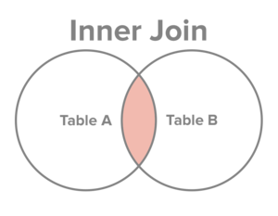
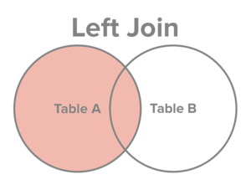
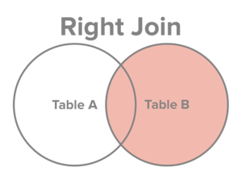
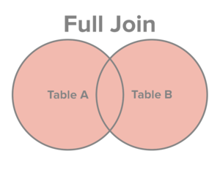
JOIN
Select all records from Table A and Table B, where the join condition is met.
Select all records from Table A, along with records from Table B for which the join condition is met (if at all).
Select all records from Table B, along with records from Table A for which the join condition is met (if at all).
Select all records from Table A and Table B, regardless of whether the join condition is met or not.

Slide 73
JOIN
customer_id | first_name | last_name | email | address | city | state | zipcode
1 | George | Washington | gwashington@usa.gov | 3200 Mt Vernon Hwy | Mount Vernon | VA | 22121
2 | John | Adams | jadams@usa.gov | 1250 Hancock St | Quincy | MA | 02169
3 | Thomas | Jefferson | tjefferson@usa.gov | 931 Thomas Jefferson Pkwy | Charlottesville | VA | 22902
4 | James | Madison | jmadison@usa.gov | 11350 Constitution Hwy | Orange | VA | 22960
5 | James | Monroe | jmonroe@usa.gov | 2050 James Monroe Parkway | Charlottesville | VA | 22902
order_id | order_date | amount | customer_id
1 | 07/04/1776 | $234.56 | 1
2 | 03/14/1760 | $78.50 | 3
3 | 05/23/1784 | $124.00 | 2
4 | 09/03/1790 | $65.50 | 3

Slide 74
JOIN
INNER JOIN
The INNER JOIN keyword selects all rows from both tables as long as there is a match between the columns in both tables.
Syntax
SELECT column_name(s) FROM table1 INNER JOIN table2 ON table1.column_name=table2.column_name;
Example
SELECT Customers.CustomerName, Orders.OrderID FROM Customers INNER JOIN Orders ON Customers.CustomerID=Orders.CustomerID ORDER BY Customers.CustomerName;
Result

Slide 75
INNER JOIN
first_name | last_name | order_date | order_amount
George | Washington | 07/4/1776 | $234.56
John | Adams | 05/23/1784 | $124.00
Thomas | Jefferson | 03/14/1760 | $78.50
Thomas | Jefferson | 09/03/1790 | $65.50

Slide 76
LEFT JOIN/LEFT OUTER JOIN
The LEFT JOIN keyword returns all rows from the left table (table1), with the matching rows in the right table (table2). The result is NULL in the right side when there is no match.
Syntax:
SELECT column_name(s) FROM table1 LEFT OUTER JOIN table2 ON table1.column_name=table2.column_name;
Example:
SELECT Customers.CustomerName, Orders.OrderID FROM Customers LEFT JOIN Orders ON Customers.CustomerID=Orders.CustomerID ORDER BY Customers.CustomerName;
Result
The LEFT JOIN keyword returns all the rows from the left table (Customers), even if there are no matches in the right table (Orders).

Slide 77
RIGHT JOIN /RIGHT OUTER JOIN
The RIGHT JOIN keyword returns all rows from the right table (table2), with the matching rows in the left table (table1). The result is NULL in the left side when there is no match.
Syntax:
SELECT column_name(s) FROM table1 RIGHT OUTER JOIN table2 ON table1.column_name=table2.column_name;
Example:
SELECT Orders.OrderID, Employees.FirstName FROM Orders RIGHT JOIN Employees ON Orders.EmployeeID=Employees.EmployeeID ORDER BY Orders.OrderID;
Result

Slide 78
FULL OUTER JOIN
The FULL OUTER JOIN keyword returns all rows from the left table (table1) and from the right table (table2).
The FULL OUTER JOIN keyword combines the result of both LEFT and RIGHT joins.
Syntax:
SELECT column_name(s) FROM table1 FULL OUTER JOIN table2 ON table1.column_name=table2.column_name;
Example:
SELECT Customers.CustomerName, Orders.OrderID FROM Customers FULL OUTER JOIN Orders ON Customers.CustomerID=Orders.CustomerID ORDER BY Customers.CustomerName;
The FULL OUTER JOIN keyword returns all the rows from the left table (Customers), and all the rows from the right table (Orders). If there are rows in "Customers" that do not have matches in "Orders", or if there are rows in "Orders" that do not have matches in "Customers", those rows will be listed as well.
Result

Slide 79
TRIGGERS
Triggers are stored programs, which are automatically executed or fired when some events occur. Triggers are, in fact, written to be executed in response to any of the following events:
A database manipulation (DML) statement (DELETE, INSERT, or UPDATE).
A database definition (DDL) statement (CREATE, ALTER, or DROP).
A database operation (SERVERERROR, LOGON, LOGOFF, STARTUP, or SHUTDOWN).
Triggers could be defined on the table, view, schema, or database with which the event is associated.

Slide 80
BENEFITS OF TRIGGERS
Triggers can be written for the following purposes:
Generating some derived column values automatically
Enforcing referential integrity
Event logging and storing information on table access
Auditing
Synchronous replication of tables
Imposing security authorizations
Preventing invalid transactions

Slide 81
CREATING TRIGGERS
CREATE [OR REPLACE ] TRIGGER trigger_name
{BEFORE | AFTER | INSTEAD OF }
{INSERT [OR] | UPDATE [OR] | DELETE}
[OF col_name]
ON table_name
[REFERENCING OLD AS o NEW AS n]
[FOR EACH ROW]
WHEN (condition)
DECLARE
Declaration-statements
BEGIN
Executable-statements
EXCEPTION
Exception-handling-statements
END;
CREATE [OR REPLACE] TRIGGER trigger_name: Creates or replaces an existing trigger with the trigger_name.
{BEFORE | AFTER | INSTEAD OF} : This specifies when the trigger would be executed. The INSTEAD OF clause is used for creating trigger on a view.
{INSERT [OR] | UPDATE [OR] | DELETE}: This specifies the DML operation.
[OF col_name]: This specifies the column name that would be updated.
[ON table_name]: This specifies the name of the table associated with the trigger.
[REFERENCING OLD AS o NEW AS n]: This allows you to refer new and old values for various DML statements, like INSERT, UPDATE, and DELETE.
[FOR EACH ROW]: This specifies a row level trigger, i.e., the trigger would be executed for each row being affected. Otherwise the trigger will execute just once when the SQL statement is executed, which is called a table level trigger.
WHEN (condition): This provides a condition for rows for which the trigger would fire. This clause is valid only for row level triggers.

Slide 82
CREATING TRIGGERS
EXAMPLE
CREATE OR REPLACE TRIGGER display_salary_changes
BEFORE DELETE OR INSERT OR UPDATE ON customers
FOR EACH ROW
WHEN (NEW.ID > 0)
DECLARE
sal_diff number;
BEGIN
sal_diff := :NEW.salary - :OLD.salary;
dbms_output.put_line('Old salary: ' || :OLD.salary);
dbms_output.put_line('New salary: ' || :NEW.salary);
dbms_output.put_line('Salary difference: ' || sal_diff);
END; /

Slide 83
STORED PROCEDURES
A subprogram is a program unit/module that performs a particular task. These subprograms are combined to form larger programs. This is basically called the 'Modular design'. A subprogram can be invoked by another subprogram or program which is called the calling program.
SQL supports two types of sub programs
Procedures
Functions
PROCEDURES
Procedure is a subprogram that performs a specific action
Syntax:
CREATE [OR REPLACE]
PROCEDURE procedure_name
[(parameter_name [IN | OUT | IN OUT] type [, ...])]
{IS | AS}
BEGIN
< procedure_body >
END procedure_name;

Slide 84
PROCEDURES
Example:
CREATE OR REPLACE
PROCEDURE greetings
AS
BEGIN dbms_output.put_line('Hello World!');
END; /
Executing a Procedure:
A standalone procedure can be called in two ways:
Using the EXECUTE keyword
Calling the name of the procedure from a PL/SQL block
The above procedure named 'greetings' can be called with the EXECUTE keyword as:
EXECUTE greetings;
(or)
BEGIN
greetings;
END; /

Slide 85
Deleting a Procedure:
Syntax: DROP PROCEDURE procedure-name;
Example: DROP PROCEDURE greetings;
Parameter Modes
S.NO. | Parameter Mode & Description
1 | IN An IN parameter lets you pass a value to the subprogram. It is a read-only parameter. Inside the subprogram, an IN parameter acts like a constant. It cannot be assigned a value. You can pass a constant, literal, initialized variable, or expression as an IN parameter. You can also initialize it to a default value; however, in that case, it is omitted from the subprogram call. It is the default mode of parameter passing. Parameters are passed by reference.
2 | OUT An OUT parameter returns a value to the calling program. Inside the subprogram, an OUT parameter acts like a variable. You can change its value and reference the value after assigning it. The actual parameter must be variable and it is passed by value.
3 | IN OUT An IN OUT parameter passes an initial value to a subprogram and returns an updated value to the caller. It can be assigned a value and its value can be read. The actual parameter corresponding to an IN OUT formal parameter must be a variable, not a constant or an expression. Formal parameter must be assigned a value. Actual parameter is passed by value.

Slide 86
FUNCTIONS
A PL/SQL function is same as a procedure except that it returns a value.
CREATING A FUNCTION
CREATE [OR REPLACE]
FUNCTION function_name
[(parameter_name [IN | OUT | IN OUT] type [, ...])]
RETURN return_datatype
{IS | AS}
BEGIN
< function_body >
END [function_name];

Slide 87
FUNCTIONS
Example:
Customer(id,name,age,address,salary)
CREATE OR REPLACE
FUNCTION totalCustomers
RETURN number IS
total number(2) := 0;
BEGIN
SELECT count(*) into total FROM customers;
RETURN total;
END; /
Calling a Function:
DECLARE c number(2);
BEGIN
c := totalCustomers();
dbms_output.put_line('Total no. of Customers: ' || c);
END; /
Output:
Total no. of Customers: 6

Slide 88
DCL
A data control language (DCL)is used to control access to data stored in a database (Authorization).
It is a component of Structured Query Language (SQL).
Examples of DCL commands include:
GRANT :Used to allow specified users to perform specified tasks.
REVOKE :Used to cancel previously granted or denied permissions.
GRANT :
SQL GRANT is a command used to provide access or privileges on the database objects to the users.
Syntax:
GRANT {ALL/SPECIFIC PERMISSIONS} ON table name TO {USER ACCOUNT} [WITH GRANT OPTION];

Slide 89
DCL
Example:
GRANT SELECT, UPDATE
ON example
TO some_user, another_user;
REVOKE:
The REVOKE command removes user access rights or privileges to the database objects.
Syntax:
REVOKE {ALL/SPECIFIC PERMISSIONS} ON table name FROM {USER ACCOUNT} [CASCADE];
Example:
REVOKE SELECT, UPDATE
ON example
FROM some_user, another_user;

Slide 90
TCL
Transaction Control Language(TCL) commands are used to manage transactions in database.
These are used to manage the changes made by DML statements.
Examples of TCL commands include:
COMMIT to apply the transaction by saving the database changes.
ROLLBACK to undo all changes of a transaction.
SAVEPOINT to divide the transaction into smaller sections. It defines breakpoints for a transaction to allow partial rollbacks.
COMMIT
Commit command is used to permanently save any transaaction into database.
Syntax:
commit;

Slide 91
TCL
Rollback
This command restores the database to last commited state. It is also use with savepoint command to jump to a savepoint in a transaction.
Syntax:
rollback to savepoint-name;
Savepoint
Savepoint command is used to temporarily save a transaction so that you can rollback to that point whenever necessary.
Syntax:
savepoint savepoint-name;
Example

Slide 92
EMBEDDED SQL
Embedded SQL is a method of combining the programming language and the database manipulation capabilities of SQL. Embedded SQL statements are SQL statements written inline with the program source code of the host language.
Example:
main()
{
exec sql include sqlca;
exec sql declare table teacher (tid char(6) not null,tname char(20),sex char(1),age number(3),qualification char(7),salary number(7),city varchar(15));
//Display a message to user
printf("updating teacher salary who are B.Techn");
//this code executes the SQL statement
exec sql update teacher set salary=1.1*salary where qualification='B.Tech';
printf(update done");
exit();
}

Slide 93
Cursor in embedded SQL
Oracle creates a memory area, known as context area, for processing an SQL statement, which contains all information needed for processing the statement, for example, number of rows processed, etc.
A cursor is a pointer to this context area.
There are two types of cursors:
Implicit cursors
Explicit cursors
Implicit cursors
Implicit cursors are automatically created by Oracle whenever an SQL statement is executed, when there is no explicit cursor for the statement. Programmers cannot control the implicit cursors and the information in it.

Slide 94
Cursor in embedded SQL
Explicit cursors
Explicit cursors are programmer defined cursors for gaining more control over the context area.
An explicit cursor should be defined in the declaration section of the PL/SQL Block.
It is created on a SELECT Statement which returns more than one row.
Syntax:
CURSOR cursor_name IS select_statement;
Working with an explicit cursor involves four steps:
Declaring the cursor for initializing in the memory
Opening the cursor for allocating memory
Fetching the cursor for retrieving data
Closing the cursor to release allocated memory

Slide 95
Cursor in embedded SQL
Declaring the Cursor:
Declaring the cursor defines the cursor with a name and the associated SELECT statement.
Example:
CURSOR c_customers IS SELECT id, name, address FROM customers;
Opening the Cursor
Opening the cursor allocates memory for the cursor and makes it ready for fetching the rows returned by the SQL statement into it.
Example:
OPEN c_customers;
Fetching the Cursor
Fetching the cursor involves accessing one row at a time.
Example :
FETCH c_customers INTO c_id, c_name, c_addr;

Slide 96
Cursor in embedded SQL
Closing the Cursor
Closing the cursor means releasing the allocated memory.
CLOSE c_customers;
EXAMPLE
Dynamic SQL
Dynamic SQL is a SQL statement that is constructed and executed at program execution time.
Dynamic SQL provides more flexibility, nevertheless, static SQL is faster and more secure than dynamic SQL.

Slide 97
STATIC VS DYNAMIC SQL
Static SQL
The source form of a static SQL statement is embedded within an application program written in a host language such as COBOL.
The statement is prepared before the program is executed and the operational form of the statement persists beyond the execution of the program.
Static SQL statements in a source program must be processed before the program is compiled.
This processing can be accomplished through the DB2 precompiler or the SQL statement coprocessor.
The DB2 precompiler or the coprocessor checks the syntax of the SQL statements, turns them into host language comments, and generates host language statements to invoke DB2.
The preparation of an SQL application program includes precompilation, the preparation of its static SQL statements, and compilation of the modified source program.

Slide 98
STATIC VS DYNAMIC SQL
Dynamic SQL
Programs that contain embedded dynamic SQL statements must be precompiled like those that contain static SQL, but unlike static SQL, the dynamic statements are constructed and prepared at run time.
The source form of a dynamic statement is a character string that is passed to DB2 by the program using the static SQL statement PREPARE or EXECUTE IMMEDIATE.

Slide 99
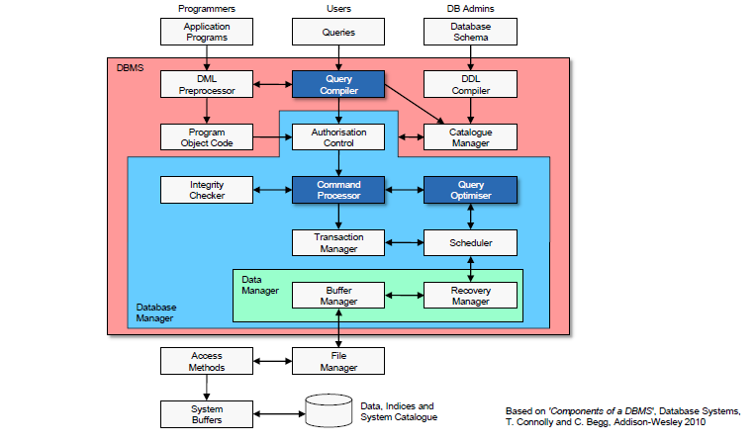

Slide 100
QUERY OPTIMIZATION
QUERY PROCESSING
It refers to the range of activities involved in extracting data from database.

Slide 101
QUERY PROCESSING
Query parsing and translation (query compiler)
check the syntax (e.g. SQL for relational DBMS)
verify that the mentioned relations do exist and replace views
transform the SQL query to a query plan represented by a relational algebra expression (for relational DBMS)
different possible relational algebra expressions for a single query
Query optimisation (query optimiser)
transform the initial query plan into the best possible query plan based on the given data set
specify the execution of single query plan operations (evaluation primitives)
e.g. which algorithms and indices to be used
the query execution plan is defined by a sequence of evaluation primitives
Query evaluation (command processor)
execute the query execution plan and return the result

Slide 102
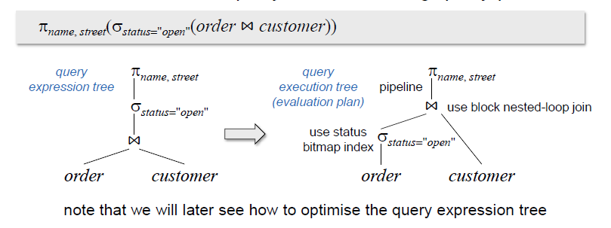
QUERY EXPRESSION AND EXECUTION
SELECT name, street FROM Customer, Order WHERE Order.customerID = Customer.customerID AND status = 'open';
Transform the SQL query to the following query plan

Slide 103
MEASURES OF QUERY COST
Cost is generally measured as total elapsed time for answering query
Many factors contribute to time cost
disk accesses, CPU, or even network communication
Typically disk access is the predominant cost, and is also relatively easy to estimate. Measured by taking into account
Number of seeks * average-seek-cost
Number of blocks read * average-block-read-cost
Number of blocks written * average-block-write-cost
Cost to write a block is greater than cost to read a block
data is read back after being written to ensure that the write was successful

Slide 104
QUERY OPTIMIZATION
The process of choosing a suitable execution strategy for processing a query.
Two internal representations of a query:
Query Tree
Query Graph

Slide 105
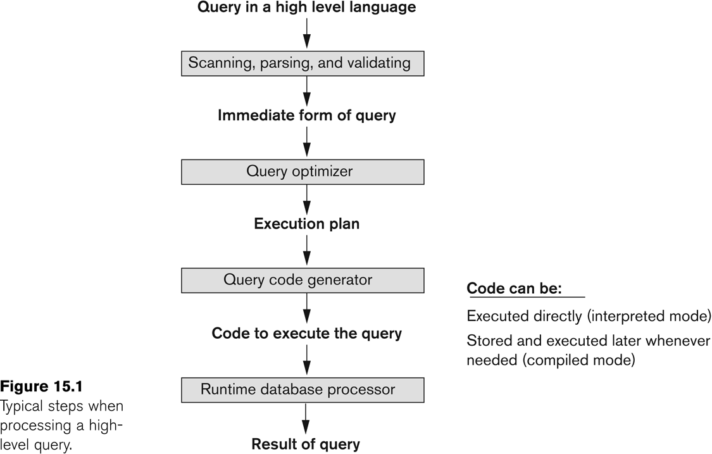
QUERY OPTIMIZATION

Slide 106
TRANSLATING SQL QUERIES INTO RELATIONAL ALGEBRA
Query block:
The basic unit that can be translated into the algebraic operators and optimized.
A query block contains a single SELECT-FROM-WHERE expression, as well as GROUP BY and HAVING clause if these are part of the block.
Nested queries within a query are identified as separate query blocks.
Aggregate operators in SQL must be included in the extended algebra.

Slide 107
TRANSLATING SQL QUERIES INTO RELATIONAL ALGEBRA
SELECT LNAME, FNAME
FROM EMPLOYEE
WHERE SALARY > ( SELECT MAX (SALARY)
FROM EMPLOYEE
WHERE DNO = 5);
SELECT LNAME, FNAME
FROM EMPLOYEE
WHERE SALARY > C
SELECT MAX (SALARY)
FROM EMPLOYEE
WHERE DNO = 5
π_{LNAME, FNAME} (σ_{SALARY>C}(EMPLOYEE))
ℱ_{MAX SALARY} (σ_{DNO=5} (EMPLOYEE))

Slide 108
ALGORITHMS FOR EXTERNAL SORTING
External sorting:
Refers to sorting algorithms that are suitable for large files of records stored on disk that do not fit entirely in main memory, such as most database files.
Sort-Merge strategy:
Starts by sorting small subfiles (runs) of the main file and then merges the sorted runs, creating larger sorted subfiles that are merged in turn.
Sorting phase: n_{R} = ⎡(b/n_{B})⎤
Merging phase: d_{M} = Min (n_{B}-1, n_{R}); n_{P} = ⎡(log_{dM}(n_{R}))⎤
n_{R}: number of initial runs; b: number of file blocks;
n_{B}: available buffer space; d_{M}: degree of merging;
n_{P}: number of passes.

Slide 109
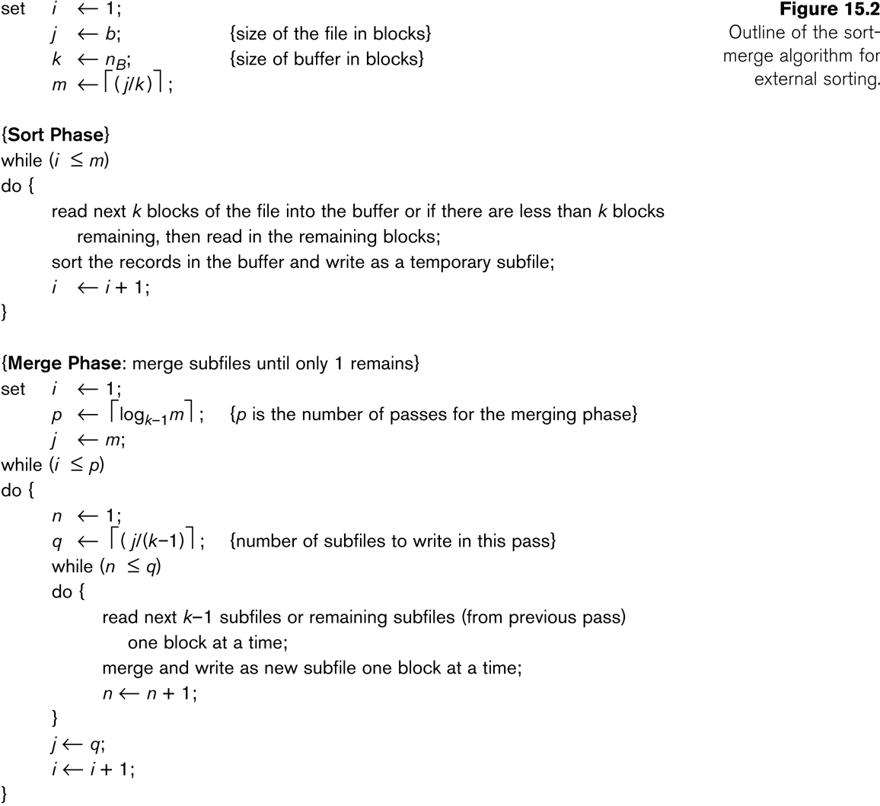
ALGORITHMS FOR EXTERNAL SORTING

Slide 110
ALGORITHMS FOR SELECT AND JOIN OPERATIONS
Implementing the SELECT Operation
Examples:
(OP1): s _{SSN='123456789'} (EMPLOYEE)
(OP2): s _{DNUMBER>5}(DEPARTMENT)
(OP3): s _{DNO=5}(EMPLOYEE)
(OP4): s DNO=5 AND SALARY>30000 AND SEX=F(EMPLOYEE)
(OP5): s _{ESSN=123456789 AND PNO=10}(WORKS_ON)

Slide 111
ALGORITHMS FOR SELECT AND JOIN OPERATIONS
Implementing the SELECT Operation (contd.):
Search Methods for Simple Selection:
S1 Linear search (brute force):
Retrieve every record in the file, and test whether its attribute values satisfy the selection condition.
S2 Binary search:
If the selection condition involves an equality comparison on a key attribute on which the file is ordered, binary search (which is more efficient than linear search) can be used. (See OP1).
S3 Using a primary index or hash key to retrieve a single record:
If the selection condition involves an equality comparison on a key attribute with a primary index (or a hash key), use the primary index (or the hash key) to retrieve the record.

Slide 112
ALGORITHMS FOR SELECT AND JOIN OPERATIONS
Implementing the SELECT Operation (contd.):
Search Methods for Simple Selection:
S4 Using a primary index to retrieve multiple records:
If the comparison condition is >, ≥, <, or ≤ on a key field with a primary index, use the index to find the record satisfying the corresponding equality condition, then retrieve all subsequent records in the (ordered) file.
S5 Using a clustering index to retrieve multiple records:
If the selection condition involves an equality comparison on a non-key attribute with a clustering index, use the clustering index to retrieve all the records satisfying the selection condition.
S6 Using a secondary (B+-tree) index:
On an equality comparison, this search method can be used to retrieve a single record if the indexing field has unique values (is a key) or to retrieve multiple records if the indexing field is not a key.
In addition, it can be used to retrieve records on conditions involving >,>=, <, or <=. (FOR RANGE QUERIES)

Slide 113
ALGORITHMS FOR SELECT AND JOIN OPERATIONS
Implementing the SELECT Operation (contd.):
Search Methods for Simple Selection:
S7 Conjunctive selection:
If an attribute involved in any single simple condition in the conjunctive condition has an access path that permits the use of one of the methods S2 to S6, use that condition to retrieve the records and then check whether each retrieved record satisfies the remaining simple conditions in the conjunctive condition.
S8 Conjunctive selection using a composite index
If two or more attributes are involved in equality conditions in the conjunctive condition and a composite index (or hash structure) exists on the combined field, we can use the index directly.

Slide 114
ALGORITHMS FOR SELECT AND JOIN OPERATIONS
Implementing the SELECT Operation (contd.):
Search Methods for Complex Selection:
S9 Conjunctive selection by intersection of record pointers:
This method is possible if secondary indexes are available on all (or some of) the fields involved in equality comparison conditions in the conjunctive condition and if the indexes include record pointers (rather than block pointers).
Each index can be used to retrieve the record pointers that satisfy the individual condition.
The intersection of these sets of record pointers gives the record pointers that satisfy the conjunctive condition, which are then used to retrieve those records directly.
If only some of the conditions have secondary indexes, each retrieved record is further tested to determine whether it satisfies the remaining conditions.

Slide 115
ALGORITHMS FOR SELECT AND JOIN OPERATION
Implementing the SELECT Operation (contd.):
Whenever a single condition specifies the selection, we can only check whether an access path exists on the attribute involved in that condition.
If an access path exists, the method corresponding to that access path is used; otherwise, the “brute force” linear search approach of method S1 is used. (See OP1, OP2 and OP3)
For conjunctive selection conditions, whenever more than one of the attributes involved in the conditions have an access path, query optimization should be done to choose the access path that retrieves the fewest records in the most efficient way.
Disjunctive selection conditions

Slide 116
ALGORITHMS FOR SELECT AND JOIN OPERATIONS
Implementing the JOIN Operation:
Join (EQUIJOIN, NATURAL JOIN)
two–way join: a join on two files
e.g. R _{A=B} S
multi-way joins: joins involving more than two files.
e.g. R _{A=B} S _{C=D} T
Examples
(OP6): EMPLOYEE _{DNO=DNUMBER} DEPARTMENT
(OP7): DEPARTMENT _{MGRSSN=SSN} EMPLOYEE

Slide 117
Algorithms for SELECT and JOIN Operations (9)
Implementing the JOIN Operation (contd.):
Methods for implementing joins:
J1 Nested-loop join (brute force):
For each record t in R (outer loop), retrieve every record s from S (inner loop) and test whether the two records satisfy the join condition t[A] = s[B].
J2 Single-loop join (Using an access structure to retrieve the matching records):
If an index (or hash key) exists for one of the two join attributes — say, B of S — retrieve each record t in R, one at a time, and then use the access structure to retrieve directly all matching records s from S that satisfy s[B] = t[A].

Slide 118
Algorithms for SELECT and JOIN Operations (10)
Implementing the JOIN Operation (contd.):
Methods for implementing joins:
J3 Sort-merge join:
If the records of R and S are physically sorted (ordered) by value of the join attributes A and B, respectively, we can implement the join in the most efficient way possible.
Both files are scanned in order of the join attributes, matching the records that have the same values for A and B.
In this method, the records of each file are scanned only once each for matching with the other file—unless both A and B are non-key attributes, in which case the method needs to be modified slightly.

Slide 119
Algorithms for SELECT and JOIN Operations (11)
Implementing the JOIN Operation (contd.):
Methods for implementing joins:
J4 Hash-join:
The records of files R and S are both hashed to the same hash file, using the same hashing function on the join attributes A of R and B of S as hash keys.
A single pass through the file with fewer records (say, R) hashes its records to the hash file buckets.
A single pass through the other file (S) then hashes each of its records to the appropriate bucket, where the record is combined with all matching records from R.

Slide 120
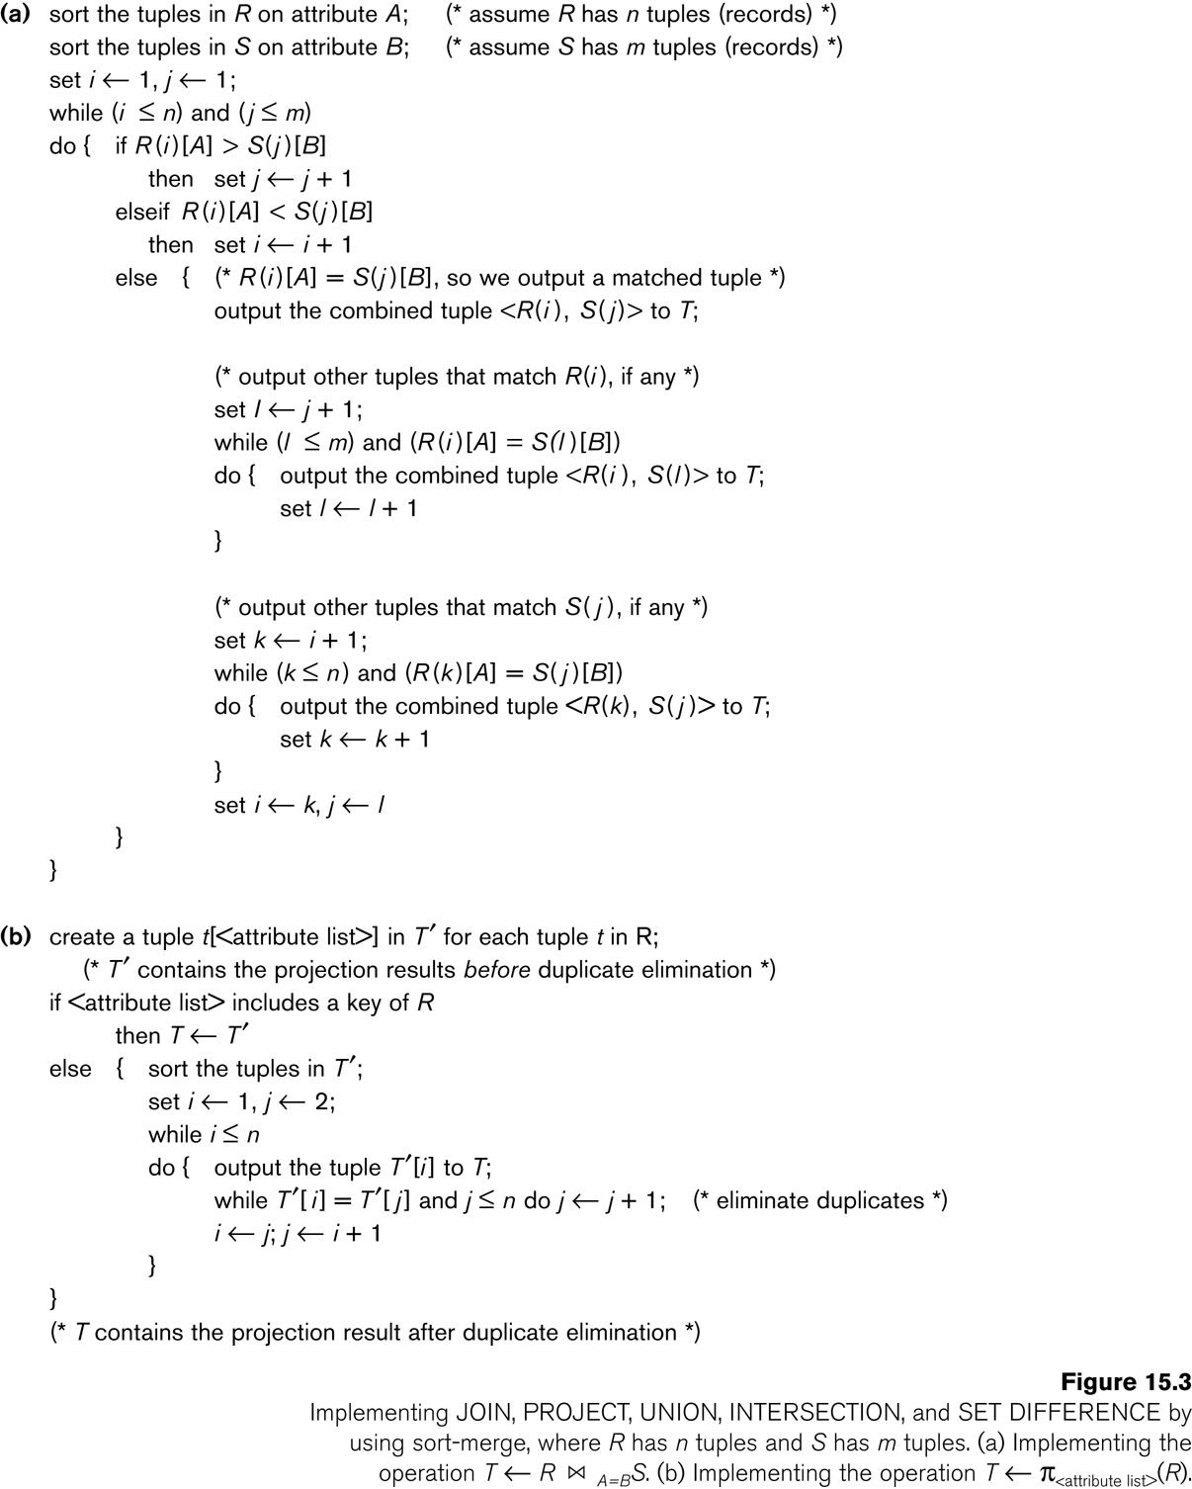
Algorithms for SELECT and JOIN Operations

Slide 121
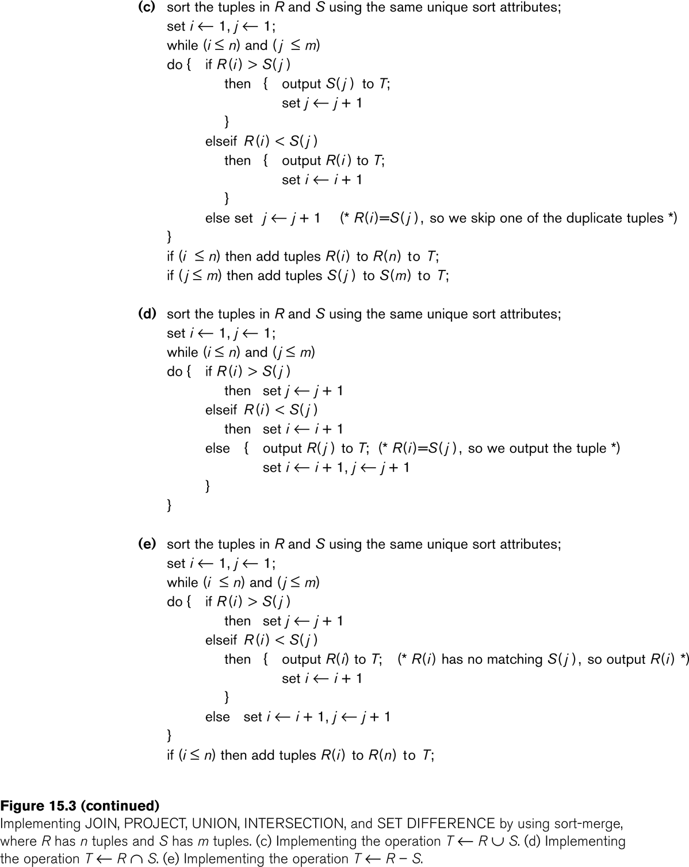
Algorithms for SELECT and JOIN Operations

Slide 122
Algorithms for SELECT and JOIN Operations (14)
Implementing the JOIN Operation (contd.):
Factors affecting JOIN performance
Available buffer space
Join selection factor
Choice of inner VS outer relation

Slide 123
Algorithms for SELECT and JOIN Operations (15)
Implementing the JOIN Operation (contd.):
Other types of JOIN algorithms
Partition hash join
Partitioning phase:
Each file (R and S) is first partitioned into M partitions using a partitioning hash function on the join attributes:
R1 , R2 , R3 , ...... Rm and S1 , S2 , S3 , ...... Sm
Minimum number of in-memory buffers needed for the partitioning phase: M+1.
A disk sub-file is created per partition to store the tuples for that partition.
Joining or probing phase:
Involves M iterations, one per partitioned file.
Iteration i involves joining partitions Ri and Si.

Slide 124
Algorithms for SELECT and JOIN Operations (16)
Implementing the JOIN Operation (contd.):
Partitioned Hash Join Procedure:
Assume Ri is smaller than Si.
Copy records from Ri into memory buffers.
Read all blocks from Si, one at a time and each record from Si is used to probe for a matching record(s) from partition Si.
Write matching record from Ri after joining to the record from Si into the result file.

Slide 125
Algorithms for SELECT and JOIN Operations (17)
Implementing the JOIN Operation (contd.):
Cost analysis of partition hash join:
Reading and writing each record from R and S during the partitioning phase: (b_{R} + b_{S}), (b_{R} + b_{S})
Reading each record during the joining phase: (b_{R} + b_{S})
Writing the result of join: b_{RES}
Total Cost:
3* (b_{R} + b_{S}) + b_{RES}

Slide 126
Algorithms for SELECT and JOIN Operations (18)
Implementing the JOIN Operation (contd.):
Hybrid hash join:
Same as partitioned hash join except:
Joining phase of one of the partitions is included during the partitioning phase.
Partitioning phase:
Allocate buffers for smaller relation- one block for each of the M-1 partitions, remaining blocks to partition 1.
Repeat for the larger relation in the pass through S.)
Joining phase:
M-1 iterations are needed for the partitions R2 , R3 , R4 , ......Rm and S2 , S3 , S4 , ......Sm. R1 and S1 are joined during the partitioning of S1, and results of joining R1 and S1 are already written to the disk by the end of partitioning phase.

Slide 127
4. Algorithms for PROJECT and SET Operations (1)
Algorithm for PROJECT operations (Figure 15.3b)
π _{<attribute list>}(R)
If <attribute list> has a key of relation R, extract all tuples from R with only the values for the attributes in <attribute list>.
If <attribute list> does NOT include a key of relation R, duplicated tuples must be removed from the results.
Methods to remove duplicate tuples
Sorting
Hashing

Slide 128
Algorithms for PROJECT and SET Operations (2)
Algorithm for SET operations
Set operations:
UNION, INTERSECTION, SET DIFFERENCE and CARTESIAN PRODUCT
CARTESIAN PRODUCT of relations R and S include all possible combinations of records from R and S. The attribute of the result include all attributes of R and S.
Cost analysis of CARTESIAN PRODUCT
If R has n records and j attributes and S has m records and k attributes, the result relation will have n*m records and j+k attributes.
CARTESIAN PRODUCT operation is very expensive and should be avoided if possible.

Slide 129
Algorithms for PROJECT and SET Operations (3)
Algorithm for SET operations (contd.)
UNION (See Figure 15.3c)
Sort the two relations on the same attributes.
Scan and merge both sorted files concurrently, whenever the same tuple exists in both relations, only one is kept in the merged results.
INTERSECTION (See Figure 15.3d)
Sort the two relations on the same attributes.
Scan and merge both sorted files concurrently, keep in the merged results only those tuples that appear in both relations.
SET DIFFERENCE R-S (See Figure 15.3e)
Keep in the merged results only those tuples that appear in relation R but not in relation S.

Slide 130
5. Implementing Aggregate Operations and Outer Joins (1)
Implementing Aggregate Operations:
Aggregate operators:
MIN, MAX, SUM, COUNT and AVG
Options to implement aggregate operators:
Table Scan
Index
Example
SELECT MAX (SALARY)
FROM EMPLOYEE;
If an (ascending) index on SALARY exists for the employee relation, then the optimizer could decide on traversing the index for the largest value, which would entail following the right most pointer in each index node from the root to a leaf.

Slide 131
Implementing Aggregate Operations and Outer Joins (2)
Implementing Aggregate Operations (contd.):
SUM, COUNT and AVG
For a dense index (each record has one index entry):
Apply the associated computation to the values in the index.
For a non-dense index:
Actual number of records associated with each index entry must be accounted for
With GROUP BY: the aggregate operator must be applied separately to each group of tuples.
Use sorting or hashing on the group attributes to partition the file into the appropriate groups;
Computes the aggregate function for the tuples in each group.
What if we have Clustering index on the grouping attributes?

Slide 132
Implementing Aggregate Operations and Outer Joins (3)
Implementing Outer Join:
Outer Join Operators:
LEFT OUTER JOIN
RIGHT OUTER JOIN
FULL OUTER JOIN.
The full outer join produces a result which is equivalent to the union of the results of the left and right outer joins.
Example:
SELECT FNAME, DNAME
FROM (EMPLOYEE LEFT OUTER JOIN DEPARTMENT
ON DNO = DNUMBER);
Note: The result of this query is a table of employee names and their associated departments. It is similar to a regular join result, with the exception that if an employee does not have an associated department, the employee's name will still appear in the resulting table, although the department name would be indicated as null.

Slide 133
Implementing Aggregate Operations and Outer Joins (4)
Implementing Outer Join (contd.):
Modifying Join Algorithms:
Nested Loop or Sort-Merge joins can be modified to implement outer join. E.g.,
For left outer join, use the left relation as outer relation and construct result from every tuple in the left relation.
If there is a match, the concatenated tuple is saved in the result.
However, if an outer tuple does not match, then the tuple is still included in the result but is padded with a null value(s).

Slide 134
Implementing Aggregate Operations and Outer Joins (5)
Implementing Outer Join (contd.):
Executing a combination of relational algebra operators.
Implement the previous left outer join example
{Compute the JOIN of the EMPLOYEE and DEPARTMENT tables}
TEMP1π_{FNAME,DNAME}(EMPLOYEE _{DNO=DNUMBER} DEPARTMENT)
{Find the EMPLOYEEs that do not appear in the JOIN}
TEMP2  π _{FNAME} (EMPLOYEE) - π_{FNAME} (Temp1)
{Pad each tuple in TEMP2 with a null DNAME field}
TEMP2  TEMP2 x 'null'
{UNION the temporary tables to produce the LEFT OUTER JOIN}
RESULT  TEMP1 υ TEMP2
The cost of the outer join, as computed above, would include the cost of the associated steps (i.e., join, projections and union).

Slide 135
6. Combining Operations using Pipelining
Motivation
A query is mapped into a sequence of operations.
Each execution of an operation produces a temporary result.
Generating and saving temporary files on disk is time consuming and expensive.
Alternative:
Avoid constructing temporary results as much as possible.
Pipeline the data through multiple operations - pass the result of a previous operator to the next without waiting to complete the previous operation.

Slide 136
Combining Operations using Pipelining
Example:
For a 2-way join, combine the 2 selections on the input and one projection on the output with the Join.
Dynamic generation of code to allow for multiple operations to be pipelined.
Results of a select operation are fed in a "Pipeline" to the join algorithm.
Also known as stream-based processing.

Slide 137
Using Heuristics in Query Optimization
Process for heuristics optimization
The parser of a high-level query generates an initial internal representation;
Apply heuristics rules to optimize the internal representation.
A query execution plan is generated to execute groups of operations based on the access paths available on the files involved in the query.
The main heuristic is to apply first the operations that reduce the size of intermediate results.
E.g., Apply SELECT and PROJECT operations before applying the JOIN or other binary operations.

Slide 138
Using Heuristics in Query Optimization
Query tree:
A tree data structure that corresponds to a relational algebra expression. It represents the input relations of the query as leaf nodes of the tree, and represents the relational algebra operations as internal nodes.
An execution of the query tree consists of executing an internal node operation whenever its operands are available and then replacing that internal node by the relation that results from executing the operation.
Query graph:
A graph data structure that corresponds to a relational calculus expression. It does not indicate an order on which operations to perform first. There is only a single graph corresponding to each query.

Slide 139
Using Heuristics in Query Optimization
Example:
For every project located in ‘Stafford’, retrieve the project number, the controlling department number and the department manager’s last name, address and birthdate.
Relation algebra:
πPNUMBER, DNUM, LNAME, ADDRESS, BDATE (((σ_{PLOCATION=‘STAFFORD’}(PROJECT))
_{DNUM=DNUMBER} (DEPARTMENT)) _{MGRSSN=SSN} (EMPLOYEE))
SQL query:
Q2: SELECT P.NUMBER,P.DNUM,E.LNAME, E.ADDRESS, E.BDATE
FROM PROJECT AS P,DEPARTMENT AS D, EMPLOYEE AS E
WHERE P.DNUM=D.DNUMBER AND D.MGRSSN=E.SSN AND P.PLOCATION=‘STAFFORD’;

Slide 140
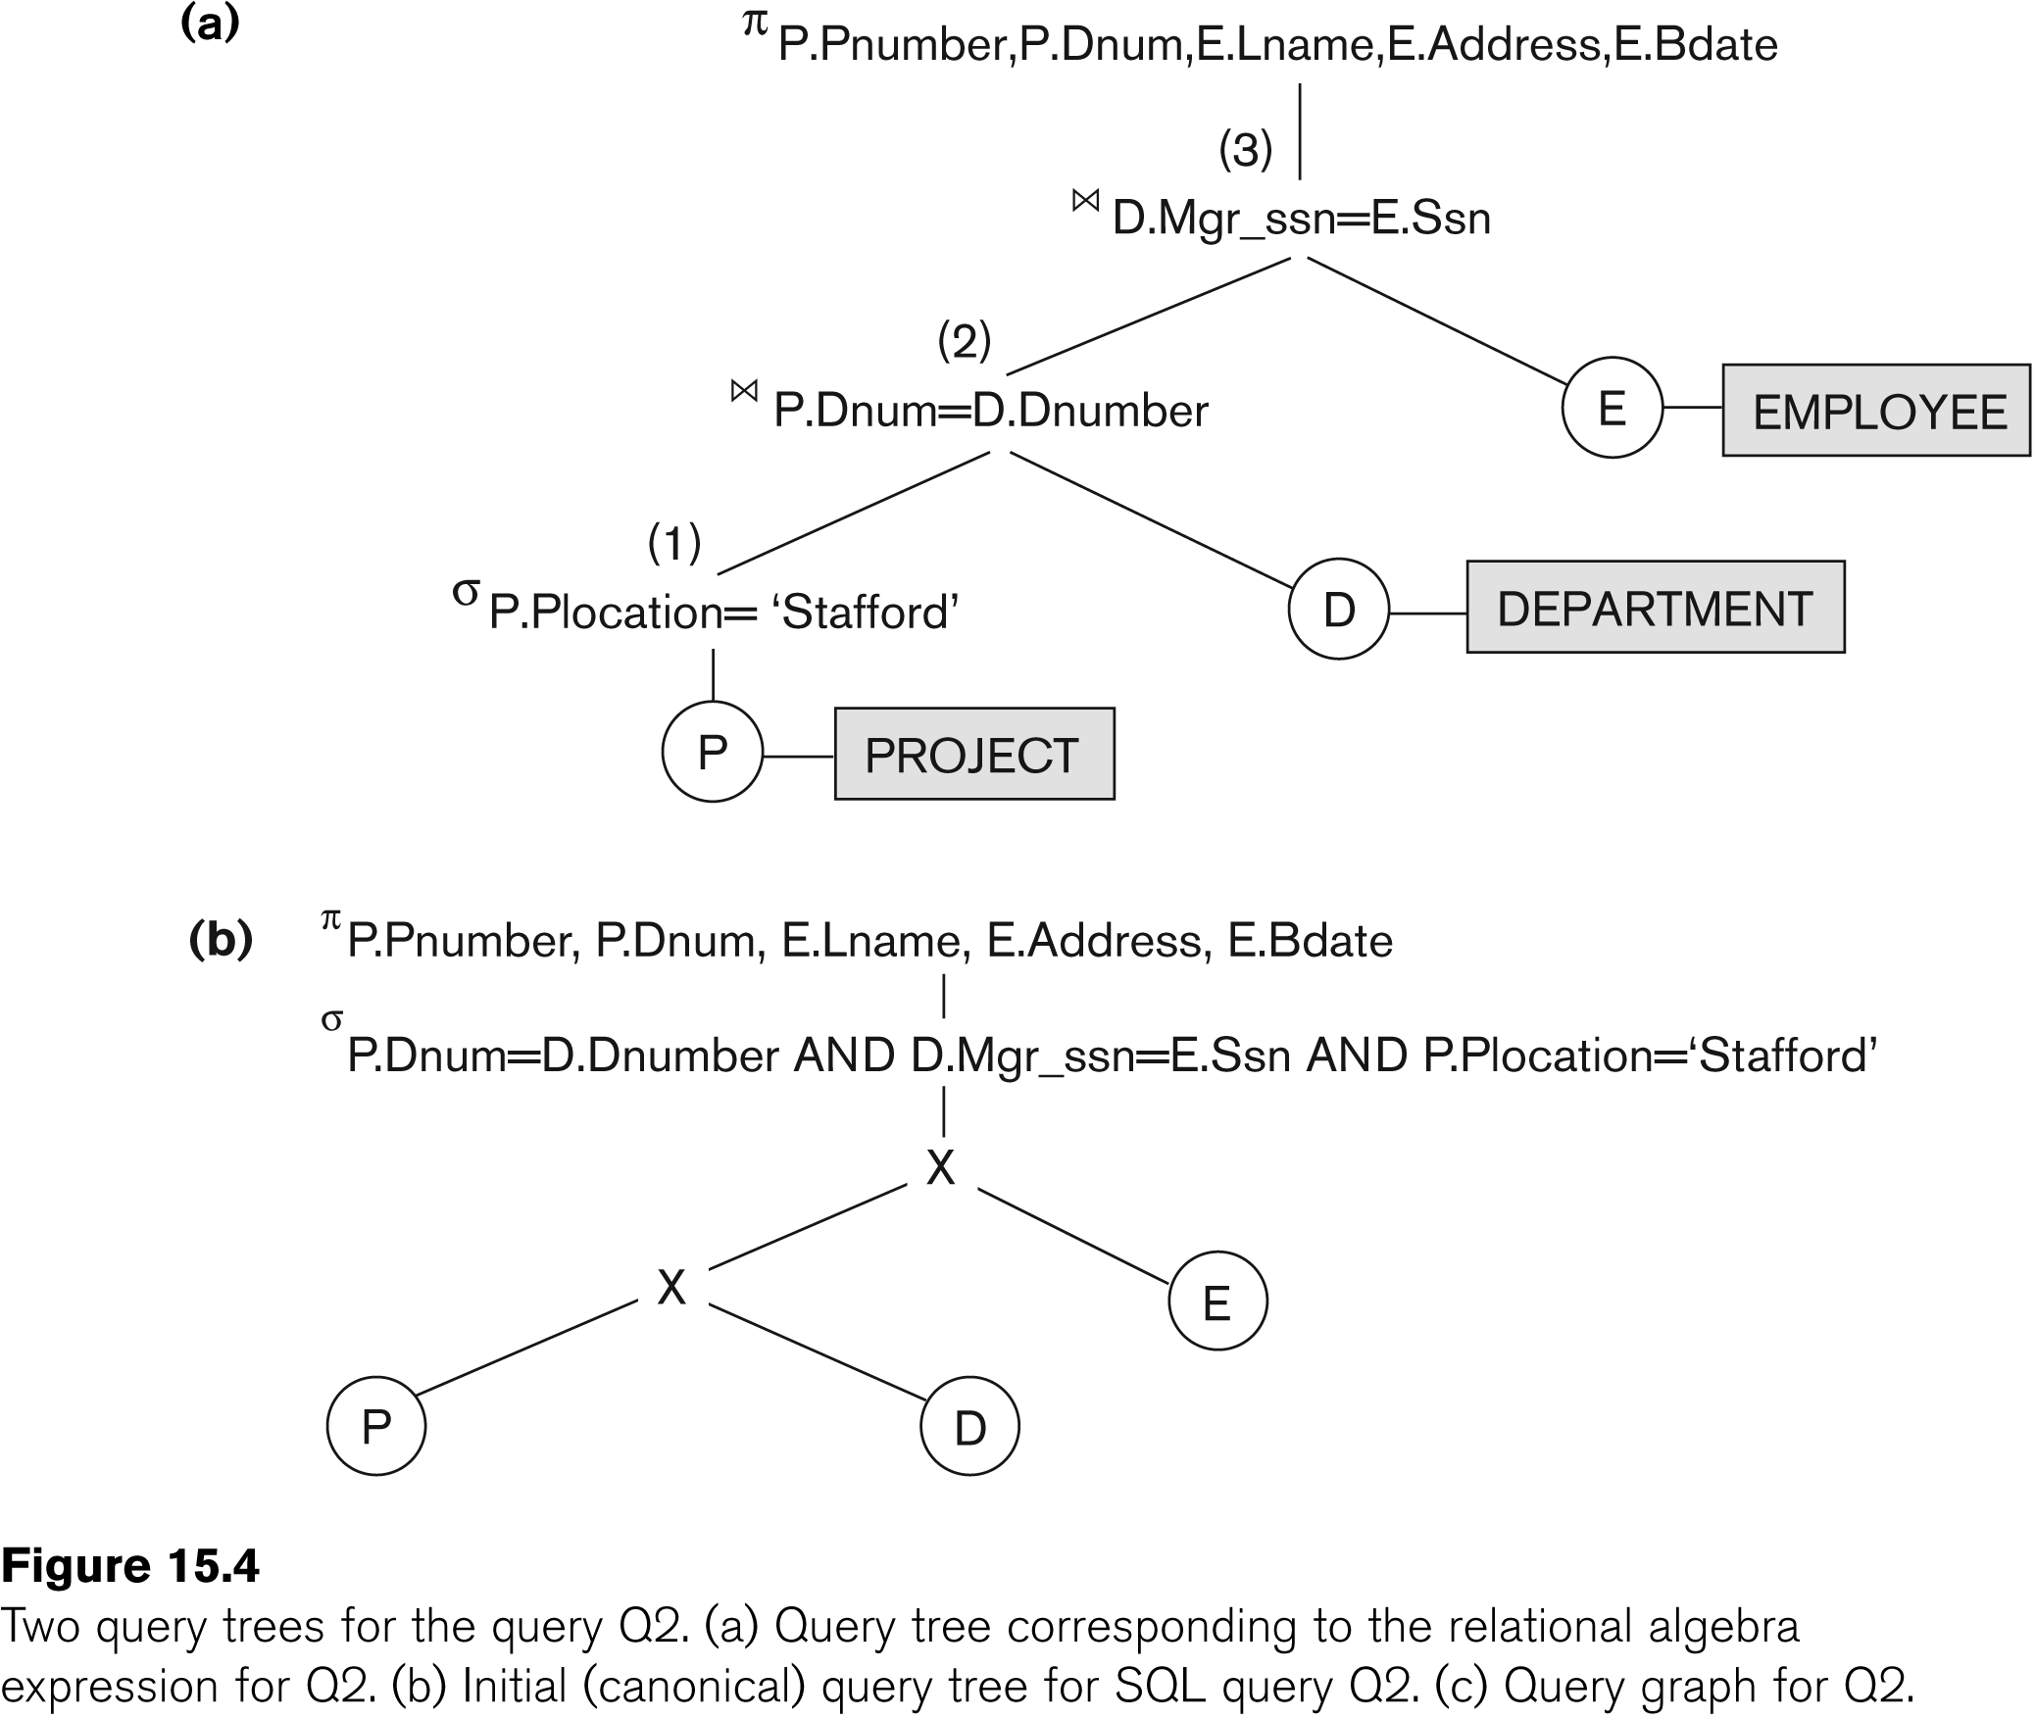
USING HEURISTICS IN QUERY OPTIMIZATION

Slide 141
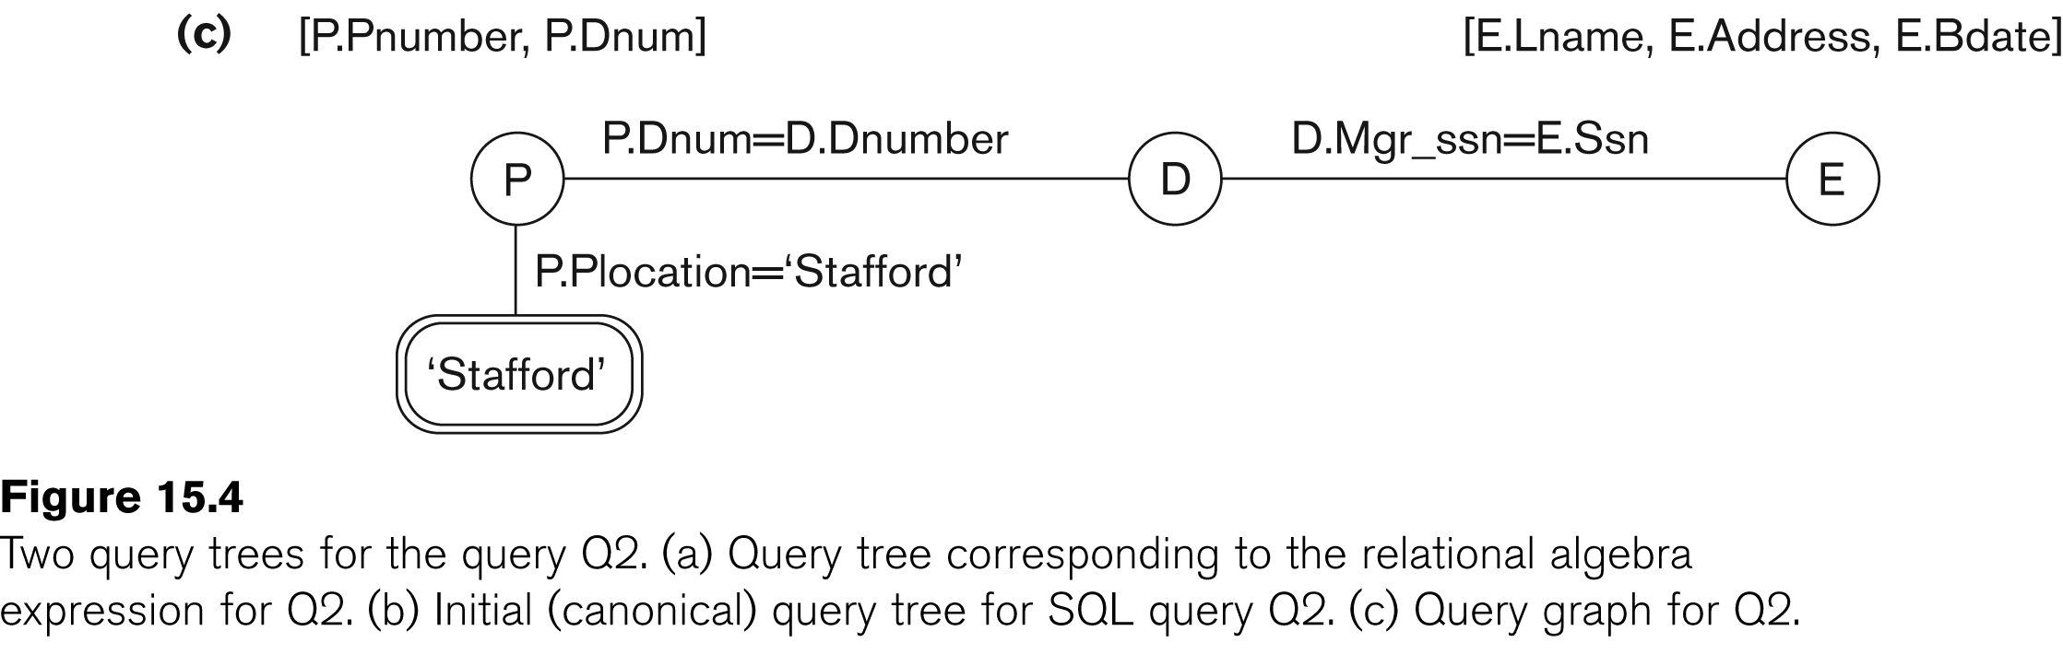
USING HEURISTICS IN QUERY OPTIMIZATION

Slide 142
USING HEURISTICS IN QUERY OPTIMIZATION
Heuristic Optimization of Query Trees:
The same query could correspond to many different relational algebra expressions — and hence many different query trees.
The task of heuristic optimization of query trees is to find a final query tree that is efficient to execute.
Example:
Q: SELECT LNAME
FROM EMPLOYEE, WORKS_ON, PROJECT
WHERE PNAME = ‘AQUARIUS’ AND PNMUBER=PNO AND ESSN=SSN AND BDATE > ‘1957-12-31’;

Slide 143
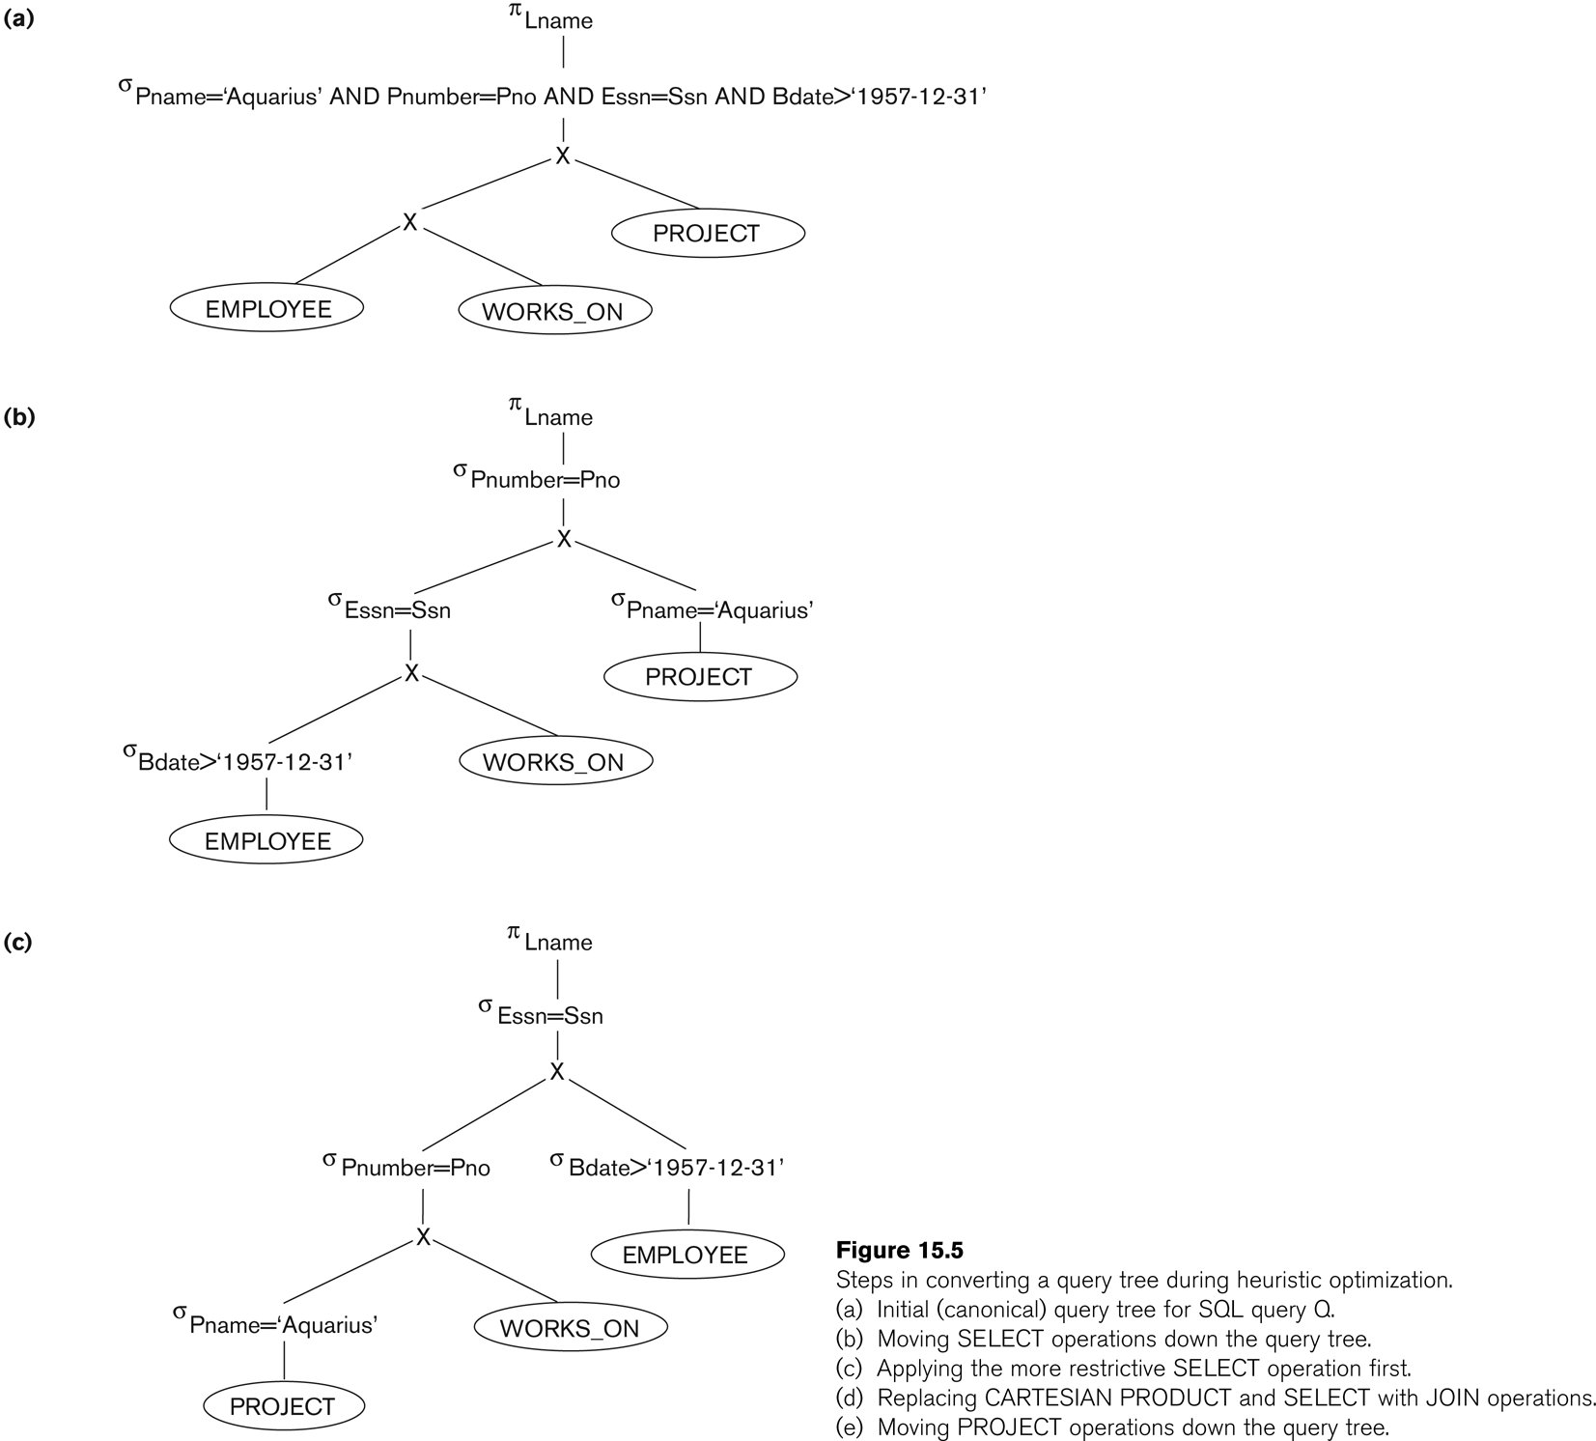
USING HEURISTICS IN QUERY OPTIMIZATION

Slide 144
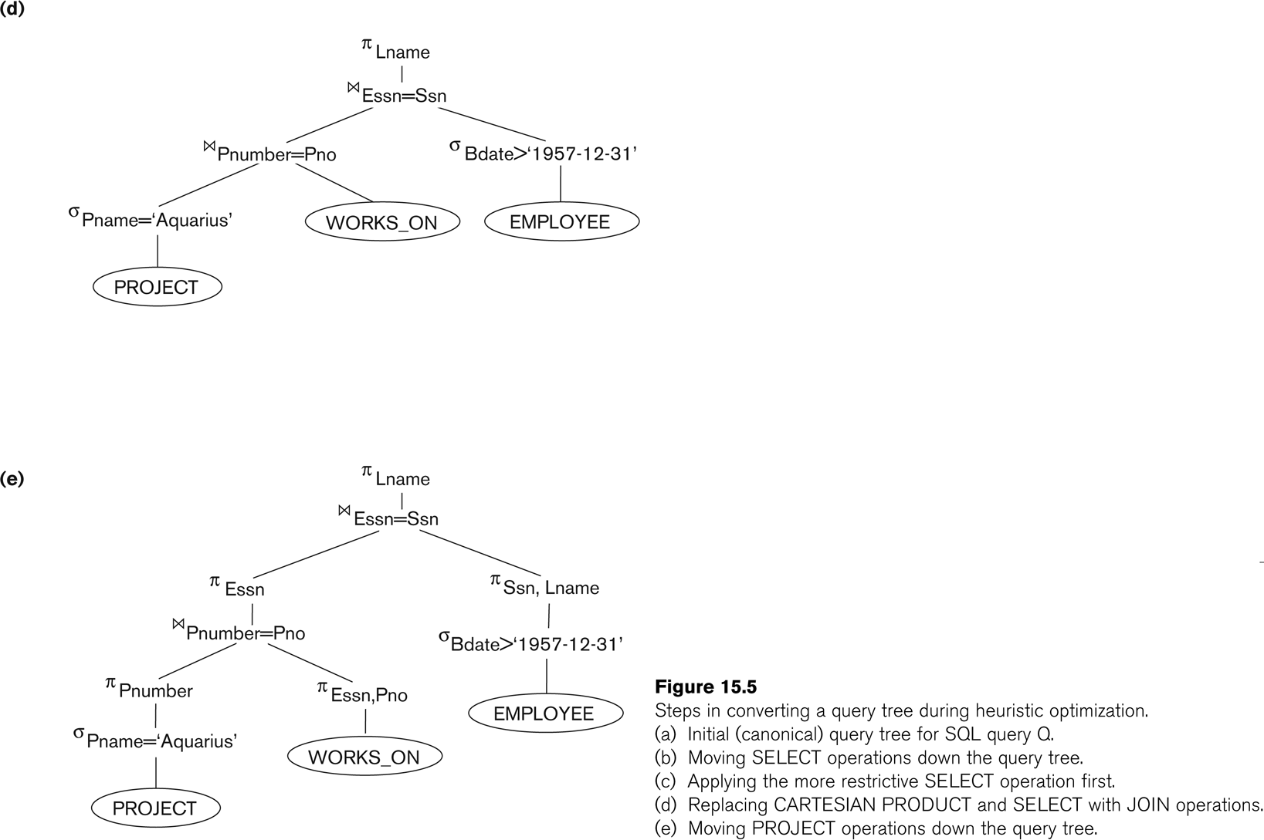
USING HEURISTICS IN QUERY OPTIMIZATION

Slide 145
Using Heuristics in Query Optimization
General Transformation Rules for Relational Algebra Operations:
1. Cascade of σ: A conjunctive selection condition can be broken up into a cascade (sequence) of individual σ operations:
σ _{c1 AND c2 AND ... AND cn}(R) = σ_{c1} (σ_{c2} (...(σ_{cn}(R))...) )
2. Commutativity of σ: The σ operation is commutative:
σ_{c1} (σ_{c2}(R)) = σ_{c2} (σ_{c1}(R))
3. Cascade of π: In a cascade (sequence) of π operations, all but the last one can be ignored:
π_{List1} (π_{List2} (...(π_{Listn}(R))...) ) = π_{List1}(R)
4. Commuting σ with π: If the selection condition c involves only the attributes A1, ..., An in the projection list, the two operations can be commuted:
π_{A1, A2, ..., An} (σ_{c} (R)) = σ_{c} (π_{A1, A2, ..., An} (R))

Slide 146
USING HEURISTICS IN QUERY OPTIMIZATION
General Transformation Rules for Relational Algebra Operations (contd.):
5. Commutativity of ( and x ): The operation is commutative as is the x operation:
R _{C} S = S _{C} R; R x S = S x R
6. Commuting σ with (or x ): If all the attributes in the selection condition c involve only the attributes of one of the relations being joined—say, R—the two operations can be commuted as follows:
σ_{c} ( R S ) = (σ_{c} (R)) S
Alternatively, if the selection condition c can be written as (c1 and c2), where condition c1 involves only the attributes of R and condition c2 involves only the attributes of S, the operations commute as follows:
σ_{c} ( R S ) = (σ_{c1} (R)) (σ_{c2} (S))

Slide 147
USING HEURISTICS IN QUERY OPTIMIZATION
General Transformation Rules for Relational Algebra Operations (contd.):
7. Commuting π with (or x): Suppose that the projection list is L = {A1, ..., An, B1, ..., Bm}, where A1, ..., An are attributes of R and B1, ..., Bm are attributes of S. If the join condition c involves only attributes in L, the two operations can be commuted as follows:
π_{L} ( R _{C} S ) = (π_{A1, ..., An} (R)) _{C} (π _{B1, ..., Bm} (S))
If the join condition C contains additional attributes not in L, these must be added to the projection list, and a final π operation is needed.

Slide 148
USING HEURISTICS IN QUERY OPTIMIZATION
General Transformation Rules for Relational Algebra Operations (contd.):
8. Commutativity of set operations: The set operations υ and ∩ are commutative but “–” is not.
9. Associativity of , x, υ, and ∩ : These four operations are individually associative; that is, if θ stands for any one of these four operations (throughout the expression), we have
( R θ S ) θ T = R θ ( S θ T )
10. Commuting σ with set operations: The σ operation commutes with υ , ∩ , and –. If θ stands for any one of these three operations, we have
σ_{c} ( R θ S ) = (σ_{c} (R)) θ (σ_{c} (S))

Slide 149
USING HEURISTICS IN QUERY OPTIMIZATION
General Transformation Rules for Relational Algebra Operations (contd.):
The π operation commutes with υ.
π_{L} ( R υ S ) = (π_{L} (R)) υ (π_{L} (S))
Converting a (σ, x) sequence into : If the condition c of a σ that follows a x Corresponds to a join condition, convert the (σ, x) sequence into a as follows:
(σ_{C} (R x S)) = (R _{C} S)
Other transformations

Slide 150
Using Heuristics in Query Optimization (14)
Outline of a Heuristic Algebraic Optimization Algorithm:
Using rule 1, break up any select operations with conjunctive conditions into a cascade of select operations.
Using rules 2, 4, 6, and 10 concerning the commutativity of select with other operations, move each select operation as far down the query tree as is permitted by the attributes involved in the select condition.
Using rule 9 concerning associativity of binary operations, rearrange the leaf nodes of the tree so that the leaf node relations with the most restrictive select operations are executed first in the query tree representation.
Using Rule 12, combine a Cartesian product operation with a subsequent select operation in the tree into a join operation.
Using rules 3, 4, 7, and 11 concerning the cascading of project and the commuting of project with other operations, break down and move lists of projection attributes down the tree as far as possible by creating new project operations as needed.
Identify subtrees that represent groups of operations that can be executed by a single algorithm.

Slide 151
Using Heuristics in Query Optimization (15)
Summary of Heuristics for Algebraic Optimization:
The main heuristic is to apply first the operations that reduce the size of intermediate results.
Perform select operations as early as possible to reduce the number of tuples and perform project operations as early as possible to reduce the number of attributes. (This is done by moving select and project operations as far down the tree as possible.)
The select and join operations that are most restrictive should be executed before other similar operations. (This is done by reordering the leaf nodes of the tree among themselves and adjusting the rest of the tree appropriately.)

Slide 152
USING HEURISTICS IN QUERY OPTIMIZATION
Query Execution Plans
An execution plan for a relational algebra query consists of a combination of the relational algebra query tree and information about the access methods to be used for each relation as well as the methods to be used in computing the relational operators stored in the tree.
Materialized evaluation: the result of an operation is stored as a temporary relation.
Pipelined evaluation: as the result of an operator is produced, it is forwarded to the next operator in sequence.

Slide 153
MATERIALIZATION
Materialized evaluation: evaluate one operation at a time, starting at the lowest-level. Use intermediate results materialized into temporary relations to evaluate next-level operations.
E.g., in figure below, compute and store
then compute the store its join with instructor, and finally compute the projection on name.

Slide 154
PIPELINING
Pipelined evaluation : evaluate several operations simultaneously, passing the results of one operation on to the next.
E.g., in previous expression tree, don’t store result of
instead, pass tuples directly to the join.. Similarly, don’t store result of join, pass tuples directly to projection.
Much cheaper than materialization: no need to store a temporary relation to disk.
Pipelining may not always be possible – e.g., sort, hash-join.
For pipelining to be effective, use evaluation algorithms that generate output tuples even as tuples are received for inputs to the operation.
Pipelines can be executed in two ways: demand driven and producer driven

Slide 155
PIPELINING (CONT.)
In demand driven or lazy evaluation
system repeatedly requests next tuple from top level operation
Each operation requests next tuple from children operations as required, in order to output its next tuple
In between calls, operation has to maintain “state” so it knows what to return next
In producer-driven or eager pipelining
Operators produce tuples eagerly and pass them up to their parents
Buffer maintained between operators, child puts tuples in buffer, parent removes tuples from buffer
if buffer is full, child waits till there is space in the buffer, and then generates more tuples
System schedules operations that have space in output buffer and can process more input tuples
Alternative name: pull and push models of pipelining

Slide 156
USING SELECTIVITY AND COST ESTIMATES IN QUERY OPTIMIZATION
Cost-based query optimization:
Estimate and compare the costs of executing a query using different execution strategies and choose the strategy with the lowest cost estimate.
Issues
Cost function
Number of execution strategies to be considered

Slide 157
USING SELECTIVITY AND COST ESTIMATES IN QUERY OPTIMIZATION
Cost Components for Query Execution
Access cost to secondary storage
Storage cost
Computation cost
Memory usage cost
Communication cost
Note: Different database systems may focus on different cost components.

Slide 158
USING SELECTIVITY AND COST ESTIMATES IN QUERY OPTIMIZATION
Catalog Information Used in Cost Functions
Information about the size of a file
number of records (tuples) (r),
record size (R),
number of blocks (b)
blocking factor (bfr)
Information about indexes and indexing attributes of a file
Number of levels (x) of each multilevel index
Number of first-level index blocks (bI1)
Number of distinct values (d) of an attribute
Selectivity (sl) of an attribute
Selection cardinality (s) of an attribute. (s = sl * r)

Slide 159
Using Selectivity and Cost Estimates in Query Optimization (4)
Examples of Cost Functions for SELECT
S1. Linear search (brute force) approach
C_{S1a} = b;
For an equality condition on a key, C_{S1a} = (b/2) if the record is found; otherwise C_{S1a} = b.
S2. Binary search:
C_{S2} = log₂b + (s/bfr)⎤ –1
For an equality condition on a unique (key) attribute, C_{S2} =log₂b
S3. Using a primary index (S3a) or hash key (S3b) to retrieve a single record
C_{S3a} = x + 1; C_{S3b} = 1 for static or linear hashing;
C_{S3b} = 1 for extendible hashing;

Slide 160
Using Selectivity and Cost Estimates in Query Optimization (5)
Examples of Cost Functions for SELECT (contd.)
S4. Using an ordering index to retrieve multiple records:
For the comparison condition on a key field with an ordering index, C_{S4} = x + (b/2)
S5. Using a clustering index to retrieve multiple records:
C_{S5} = x + ┌ (s/bfr) ┐
S6. Using a secondary (B+-tree) index:
For an equality comparison, C_{S6a} = x + s;
For an comparison condition such as >, <, >=, or <=,
C_{S6a} = x + (b_{I1}/2) + (r/2)

Slide 161
Using Selectivity and Cost Estimates in Query Optimization (6)
Examples of Cost Functions for SELECT (contd.)
S7. Conjunctive selection:
Use either S1 or one of the methods S2 to S6 to solve.
For the latter case, use one condition to retrieve the records and then check in the memory buffer whether each retrieved record satisfies the remaining conditions in the conjunction.
S8. Conjunctive selection using a composite index:
Same as S3a, S5 or S6a, depending on the type of index.
Examples of using the cost functions.

Slide 162
Using Selectivity and Cost Estimates in Query Optimization (7)
Examples of Cost Functions for JOIN
Join selectivity (js)
js = | (R _{C} S) | / | R x S | = | (R _{C} S) | / (|R| * |S |)
If condition C does not exist, js = 1;
If no tuples from the relations satisfy condition C, js = 0;
Usually, 0 <= js <= 1;
Size of the result file after join operation
| (R _{C} S) | = js * |R| * |S |

Slide 163
Using Selectivity and Cost Estimates in Query Optimization (8)
Examples of Cost Functions for JOIN (contd.)
J1. Nested-loop join:
C_{J1} = b_{R} + (b_{R}*b_{S}) + ((js* |R|* |S|)/bfr_{RS})
(Use R for outer loop)
J2. Single-loop join (using an access structure to retrieve the matching record(s))
If an index exists for the join attribute B of S with index levels x_{B}, we can retrieve each record s in R and then use the index to retrieve all the matching records t from S that satisfy t[B] = s[A].
The cost depends on the type of index.

Slide 164
Using Selectivity and Cost Estimates in Query Optimization (9)
Examples of Cost Functions for JOIN (contd.)
J2. Single-loop join (contd.)
For a secondary index,
C_{J2a} = b_{R} + (|R| * (x_{B} + s_{B})) + ((js* |R|* |S|)/bfr_{RS});
For a clustering index,
C_{J2b} = b_{R} + (|R| * (x_{B} + (s_{B}/bfr_{B}))) + ((js* |R|* |S|)/bfr_{RS});
For a primary index,
C_{J2c} = b_{R} + (|R| * (x_{B} + 1)) + ((js* |R|* |S|)/bfr_{RS});
If a hash key exists for one of the two join attributes — B of S
C_{J2d} = b_{R} + (|R| * h) + ((js* |R|* |S|)/bfr_{RS});
J3. Sort-merge join:
C_{J3a} = C_{S} + b_{R} + b_{S} + ((js* |R|* |S|)/bfr_{RS});
(CS: Cost for sorting files)

Slide 165
Using Selectivity and Cost Estimates in Query Optimization (10)
Multiple Relation Queries and Join Ordering
A query joining n relations will have n-1 join operations, and hence can have a large number of different join orders when we apply the algebraic transformation rules.
Current query optimizers typically limit the structure of a (join) query tree to that of left-deep (or right-deep) trees.
Left-deep tree:
A binary tree where the right child of each non-leaf node is always a base relation.
Amenable to pipelining
Could utilize any access paths on the base relation (the right child) when executing the join.

Slide 166
INTEGRITY
Data integrity refers to the correctness and completeness of the data in a database, i.e. an integrity constraint is a mechanism used to prevent invalid data entry into the table.
The various types of integrity constraints are
Domain integrity constraints
Entity integrity constraints
Referential integrity constraints
Domain integrity constraints
These constraints set a range, and any violations that take place will prevent the user from performing the manipulation that caused the breach.
There are two types of domain integrity constraints
Not null constraint
Check constraint

Slide 167
INTEGRITY
Not null constraint
By default all columns in a table allow null values -when a 'Not Null' constraint is enforced though, either on a column or set of columns in a table, it will not allow Null values.
The user has to provide a value for the column.
Check constraint
Check constraints a database.
Each entity represents a table and each row of a table represents an instance of that entity.
Each row in a table can be uniquely identified using the entity constraints.
Example:
CREATE TABLE Persons ( P_Id int NOT NULL, LastName varchar(255) NOT NULL, FirstName varchar(255), Address varchar(255), City varchar(255), CONSTRAINT chk_Person CHECK (P_Id>0 AND City='Sandnes') )

Slide 168
INTEGRITY
Unique constraints
Primary key constraints
Unique constraints
Unique key constraints is used to prevent the duplication of values within the rows of a specified column or a set of columns in a table.
Columns defined with this constraint can also allow Null values.
Primary key constraints
The primary key constraint avoids duplication of rows and does not allow Null values, when enforced in a column or set of columns.
As a result it is used to identify a row. A table can have only one primary key.
Primary key constraint cannot be defined in an alter table command when the table contains rows having null values.

Slide 169
INTEGRITY
Referential integrity constraints
Referential integrity constraint is used to establish a 'parent-child' relationship between two tables having a common column.
To implement this, define the column in the parent table as a primary key and the same column in the child table as a foreign key referring to the corresponding parent entry.
Creating constraints on a new table
Crate table (column-name 1 datatype(size) constraint primary key, column-name2 datatype(size) constraint references referenced table[(column-name)], coIumn-name3 datatype(size) constraint check(), column-name4 datatype(size) NOT NULL, column-name5 datatype(size) UNIQUE);

